Slide 1

Biodegradable water absorbing geocomposites (BioWAG) and soil microorganisms for enhanced phytoremediation of heavy metals
Krzysztof Lejcuś¹, Ahmed Tamma¹, Wiesław Fiałkiewicz¹, Daria Marczak¹, Jakub Misiewicz¹, Aleksandra Bawiec¹,
Agnieszka Medyńska-Juraszek², Zbigniew Lazar³, Anna Kancelista³
1 Institute of Environmental Engineering, Wrocław University of Environmental and Life Sciences, Wrocław, Poland
2 Institute of Soil Science, Plant Nutrition and Environmental Protection, Wrocław University of Environmental and Life Sciences, Wrocław, Poland
3 Department of Biotechnology and Food Microbiology, Wrocław University of Environmental and Life Sciences, Wrocław, Poland
9th Europeum Bioremediation Conference (EBC – IX), June 15-19 2025, Chania Greece

Slide 2

SYMBIOREM
Symbiotic, circular bioremediation systems and biotechnology solutions for improved environmental, economic and social sustainability in pollution control”
https://symbiorem.eu/

Slide 3
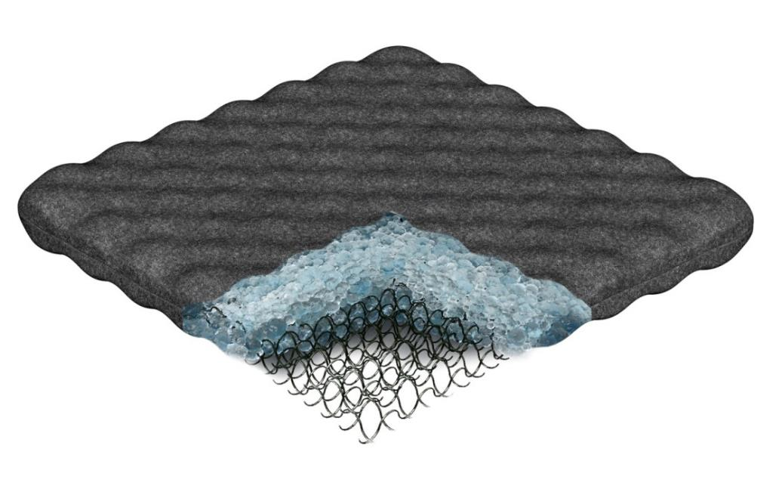
The water absorbing geocomposite (WAG)
The water absorbing geocomposite (WAG) is a new type of soil additive. It is a spatial structure capturing water in the soil and retaining it inside in the form of a gel. This innovative technology enables efficient water retention in the soil. Later, the water is absorbed by plant roots.
nonwoven
https://hydrobox.pl/
superabsorbent
(SAP)
internal structure

Slide 4
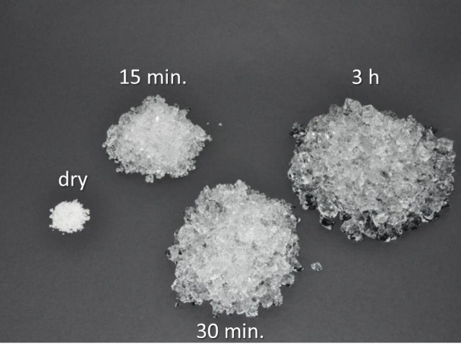
Superabsorbent (SAP)
Superabsorbents (SAPs) or hydrogels are loosely cross-linked polymers
1g of SAP can absorb up to 1000g of water
SAPs are used in medicine, hygienic industry and in agriculture
In the soil they perform the function of a moisture buffer

Slide 5
Geotextile
Separates from the soil
It captures water into the geocomposite
Makes installation easier and possible removal from the soil if necessary
Designed to work in the different conditions (capillary break phenomena)
Lejcuś et al. 2016. Optimisation of operational parameters for nonwoven sheaths of water absorbing geocomposites in unsaturated soil conditions. Fibres & Textiles in Eastern Europe 24, 3 (117)

Slide 6
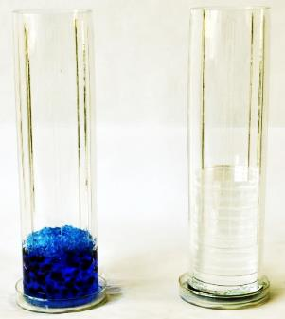
Why this internal skeleton?
Absorption under load ς = 1.3 g∙cm⁻³,
Lejcuś et al. 2018. Swelling Behaviour of Superabsorbent Polymers for Soil Amendment under Different Loads. Polymers 2018, 10(3), 271
SAP without load
SAP with load

Slide 7
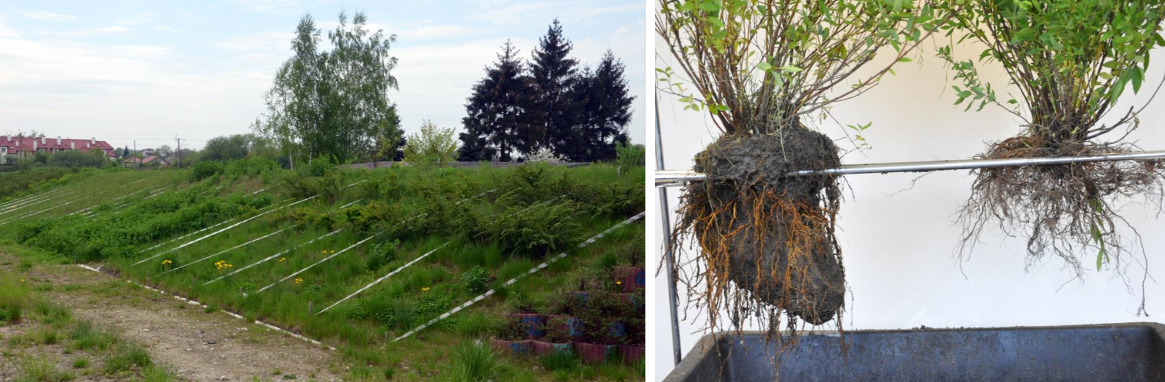
Applications

Slide 8

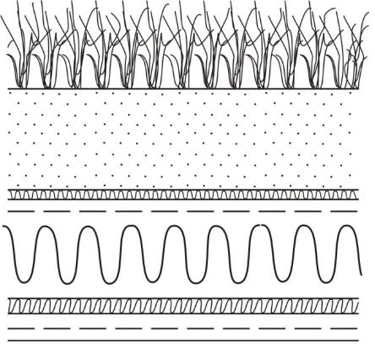
Applications
Grasses, succulents
Geogrid
Vegation layer 10-30 cm
WAG 20 mm
Other constuction layers

Slide 9
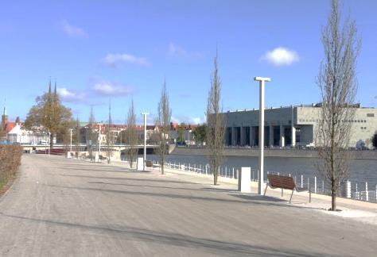
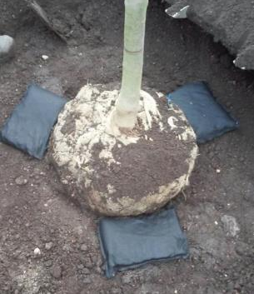
Applications

Slide 10
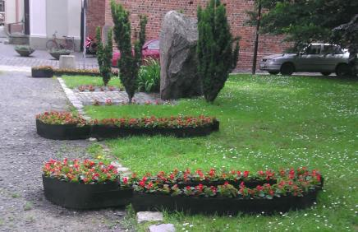
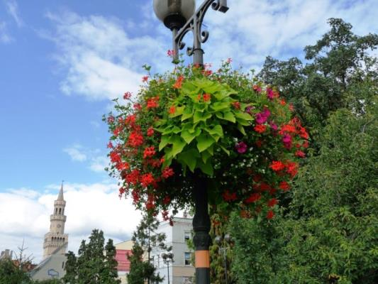
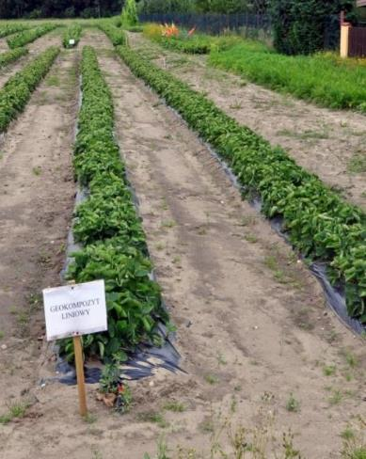
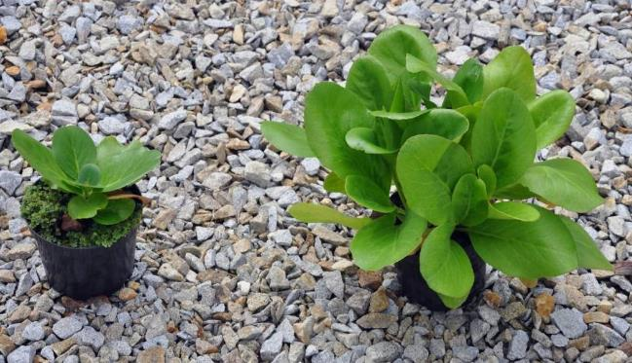
Applications

Slide 11
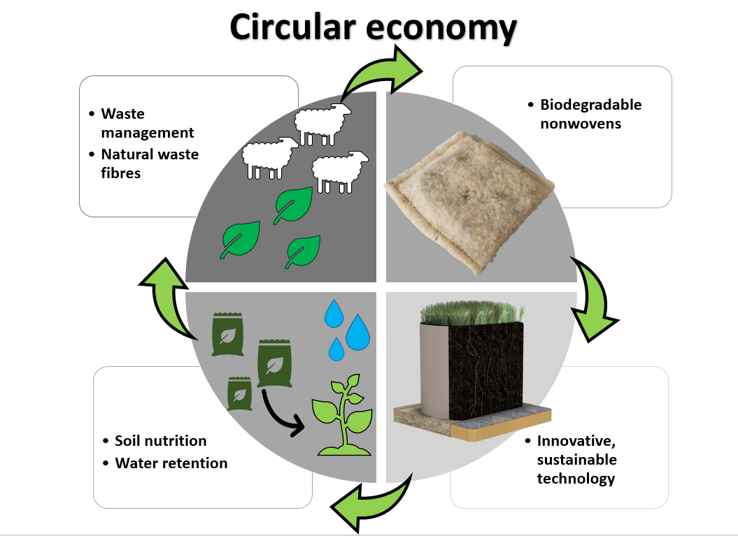
Biodegradable version of water absorbing geocomposites (BioWAG)
Currently, biodegradable water-absorbing geocomposites are manufactured in accordance with natural textile waste such as: wool, jute, linen.
Marczak Daria, Lejcuś Krzysztof, Kulczycki Grzegorz, Misiewicz Jakub: Towards circular economy: Sustainable soil additives from natural waste fibres to improve water retention and soil fertility, Science of the Total Environment, 2022, vol. 844, nr 20, s.1-15, DOI:10.1016/j.scitotenv.2022.157169.

Slide 12
Purpose of the research
The aim of the work is to develop a new technology for phytoextraction of metals from soil with the use of BioWAG based on sustainable methods, materials, and amendments.
The selection of a suitable soil amendments, microorganisms and natural organic acids which will help the growth of the selected plants and the targeted metal bioavailability in the contaminated soil.
The development of biodegradable water absorbing geocomposit (BioWAG) that will be able to work with phytoextraction and make it more efficient.

Slide 13
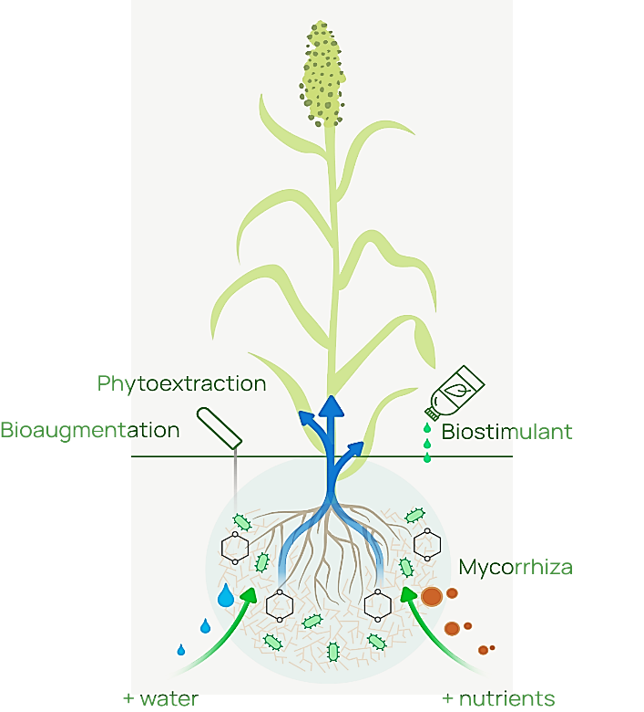


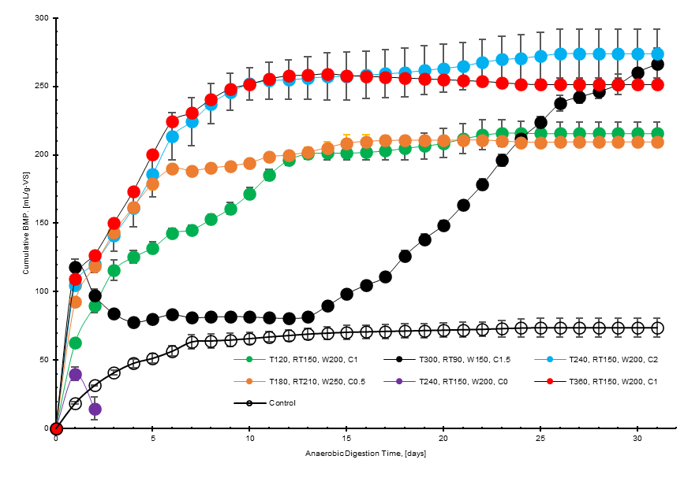
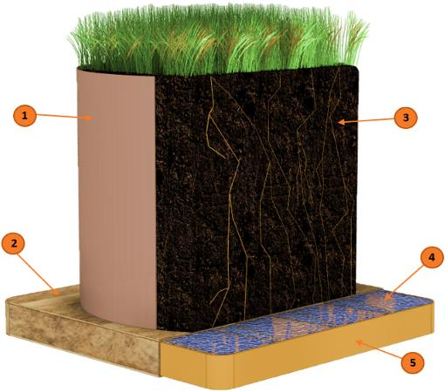


RESEARCH CONCEPT
2- Adding the selected soil Amendments
1- Integrating the (WAG) to the phytoextraction experiment
analysis
synthetic cover
soil
nonwoven
superabsorbent (SAP)
Produced Biomass
Organic acids
BioWAG
internal structure
Cr
Pb

Slide 14
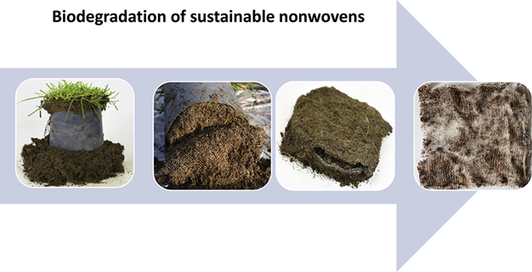
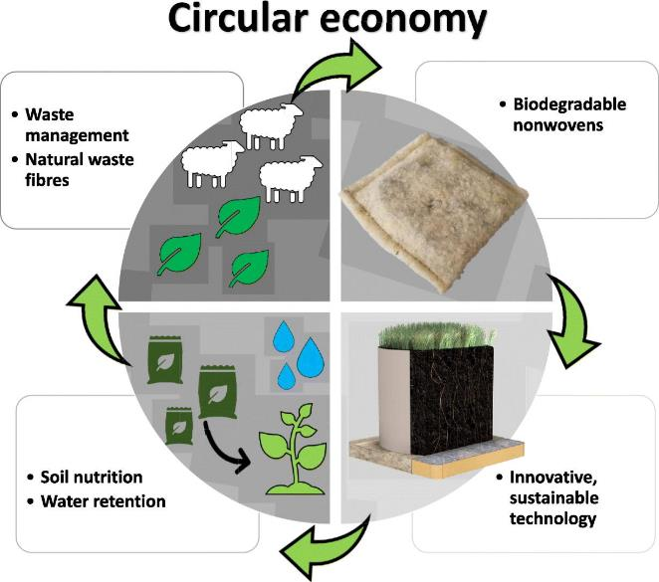
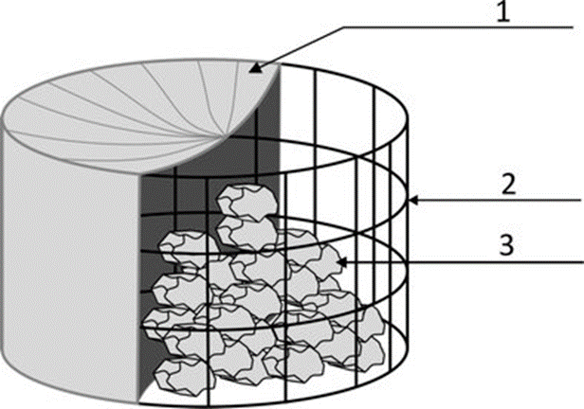
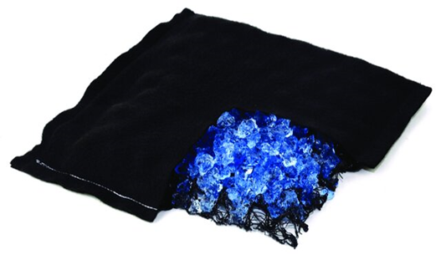
Water Absorbing Geocomposite (WAG)
biodegradability
What is it?
WAG can be produced in long-lasting and fully biodegradable version which also provides nutrient to plants.
Water-absorbing Geocomposite (WAG) technology retains water in the soil, supporting plant growth by reducing water stress and minimizing the need for frequent watering. This cost-effective solution is applicable in various vegetation scenarios, enhancing plant resilience and development.
geotextile
Skelton
Cross-section of water absorbing geocomposite.
Super-absorbent absorbing water

Slide 15
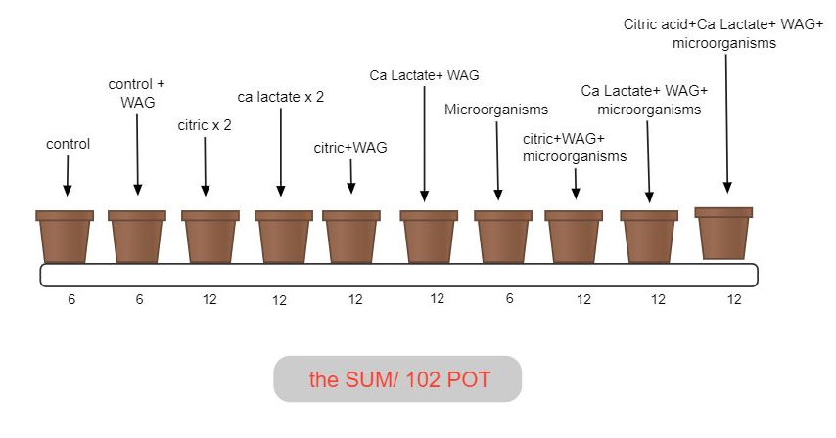
Greenhouse Experiment

Slide 16
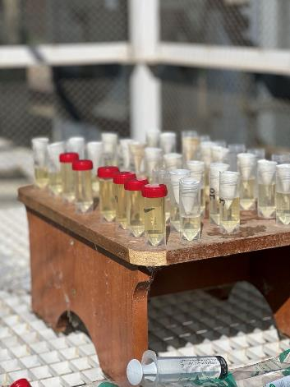
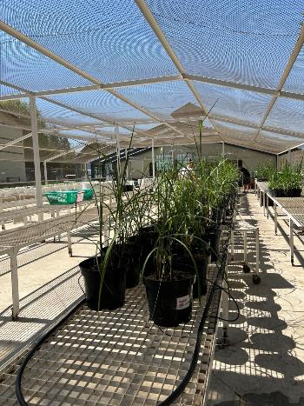
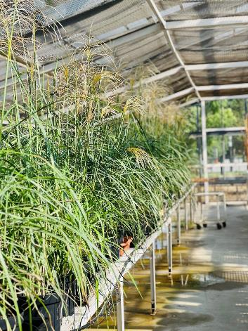
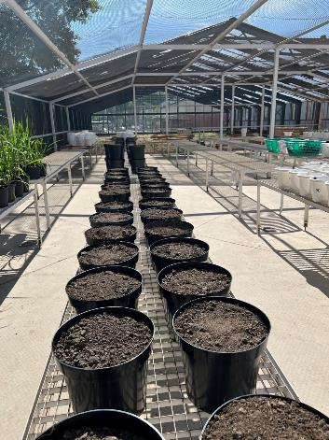
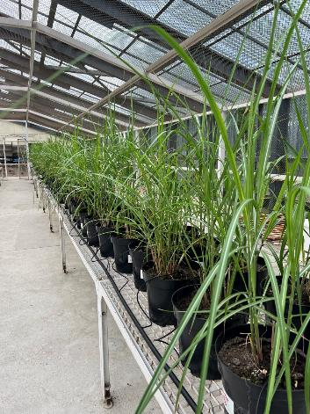
Greenhouse Experiment

Slide 17
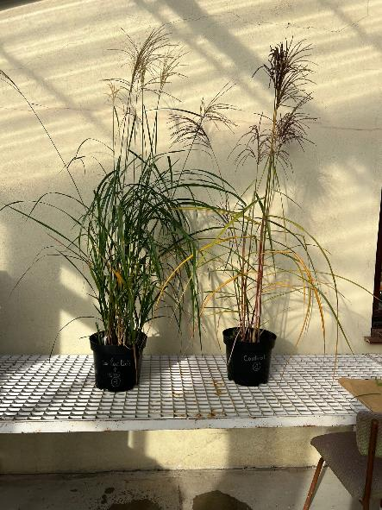
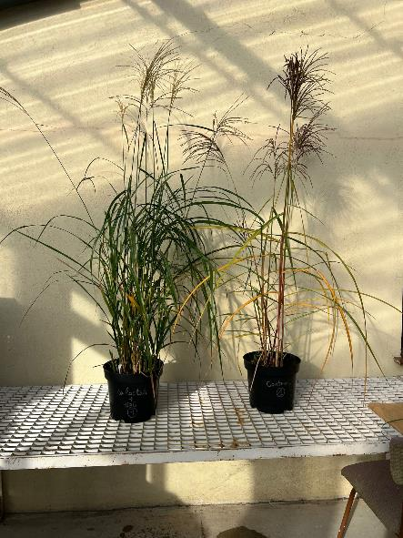
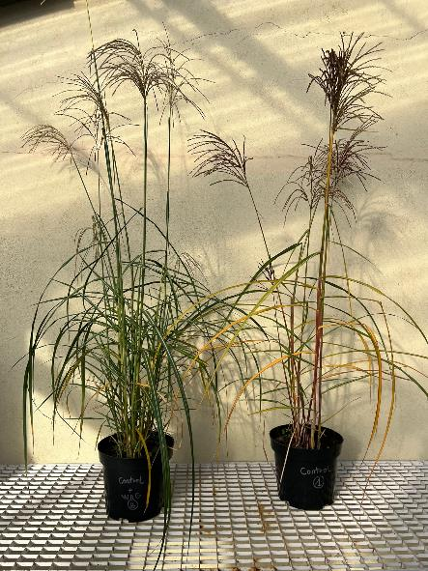
Plants with and without BioWAG

Slide 18
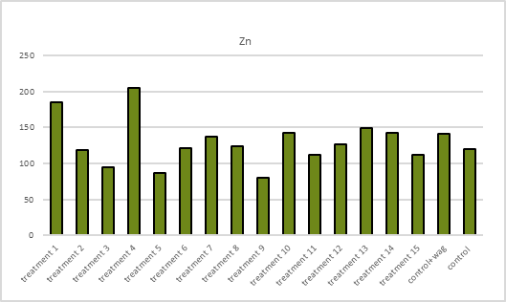
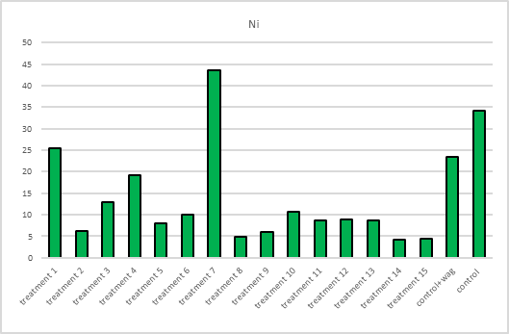
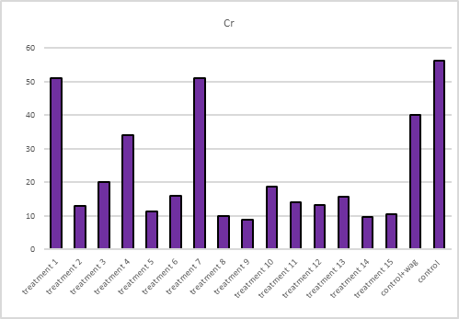
Results – metal concentration [mg/kg d.m]

Slide 19
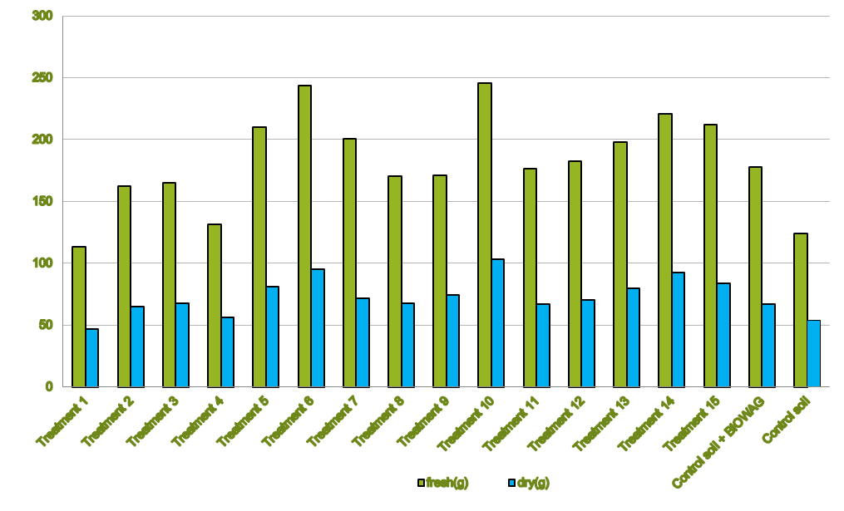
Results – fresh and dry biomass [g]

Slide 20
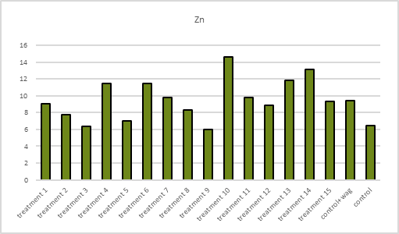
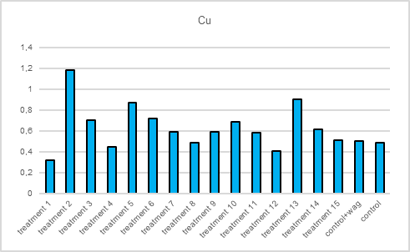
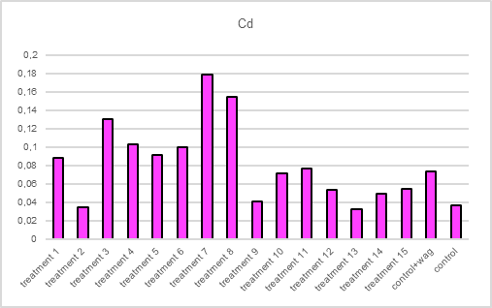
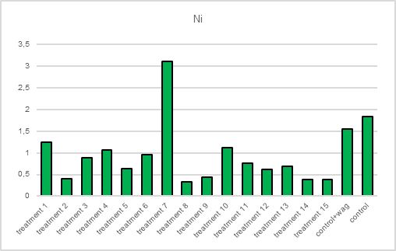
Results – metal uptake [mg/kg d.m]

Slide 21
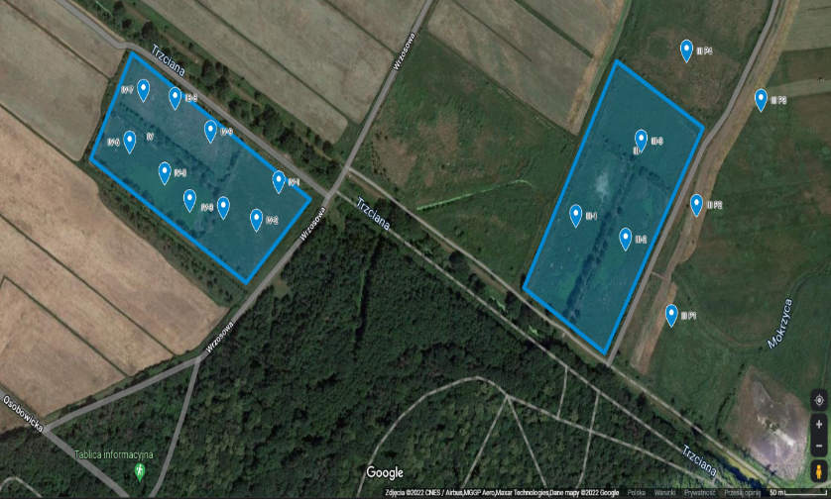
Study site location
Osobowice irrigation fields
It served as the Wroclaw's natural sewage treatment plant for over a hundred years. The beginning of the exploitation of the fields dates back to the year 1880. The object is located in the north part of Wroclaw, on the Wroclaw Plain – between rivers Odra and Widawa

Slide 22
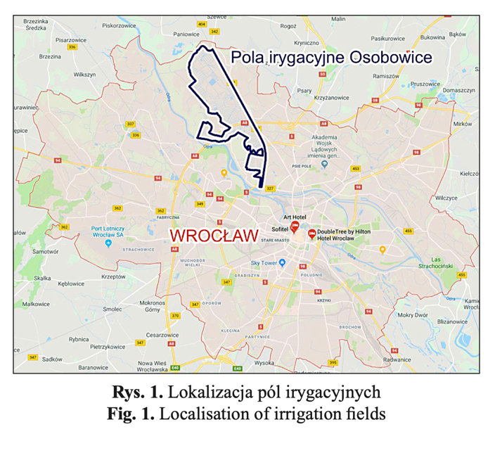
Study site location
Remediation field experiment for UPWr case study is located at Osobowice irrigation fields (51°09'57.5"N 16°59'27.3"E) in the north part of Wrocław City.
Soils in the fields has been classified as alluvial soils – Fluvisols (FAO – WRB Soil Classification System). Mainly composed from sandy clays and loose sands.
Due to over 100 years of soil enrichment with high loads of nutrients (mainly N and P) permissible concentrations of nitrates are exceeded in ground waters, soil and surface waters in this area. Soil pH is mainly acidic or slightly acidic, with a high content of organic carbon (up to 6,5% of C_{org}).

Slide 23
Conditions
Irrigation fields is facing the problem of elevated heavy metal. Pb (up to 89 mg/kg), Zn (up to 272 mg/kg) and Cd (up to 2,9 mg/kg) are the main contaminants in tested soils, however locally Cr, Cu and Ni also is much higher than natural background levels.
A synthetic consortium of microorganisms was introduced into the BioWAG, composed of Trichoderma atroviride SYM12, Yarrowia lipolytica 24/II, Rhizobium sp. 1.8, and Levilactobacillus brevis III, at a density of 1×10⁵ cells/g of soil. BioWAG box was installed below the root system of Miscanthus sinensis which was used as a phytoremediation plant.

Slide 24
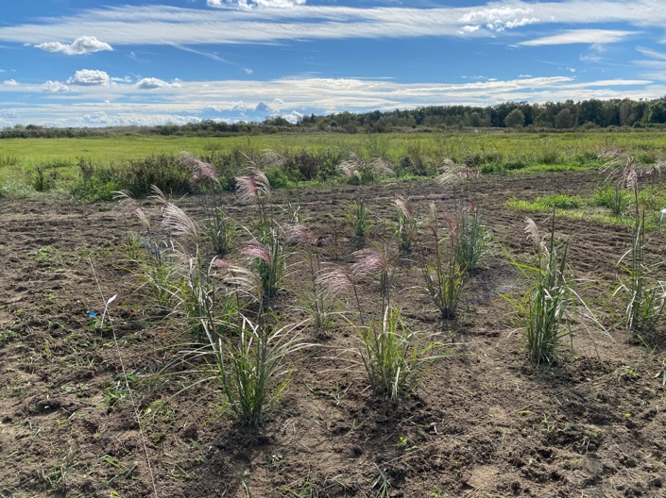
Experimental site
Experimental site was located at sandy clay soil with elevated or exceeding law standards concentrations of Pb, Cd and Zn.
Different treatments with/without WAG and co-application or no application of low molecular organic acid and microorganism are tested on site.

Slide 25
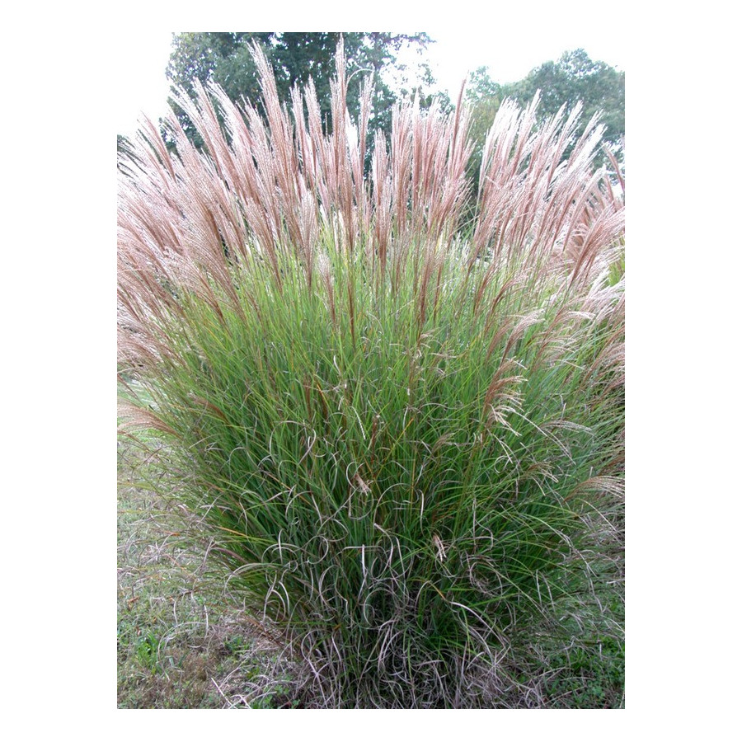
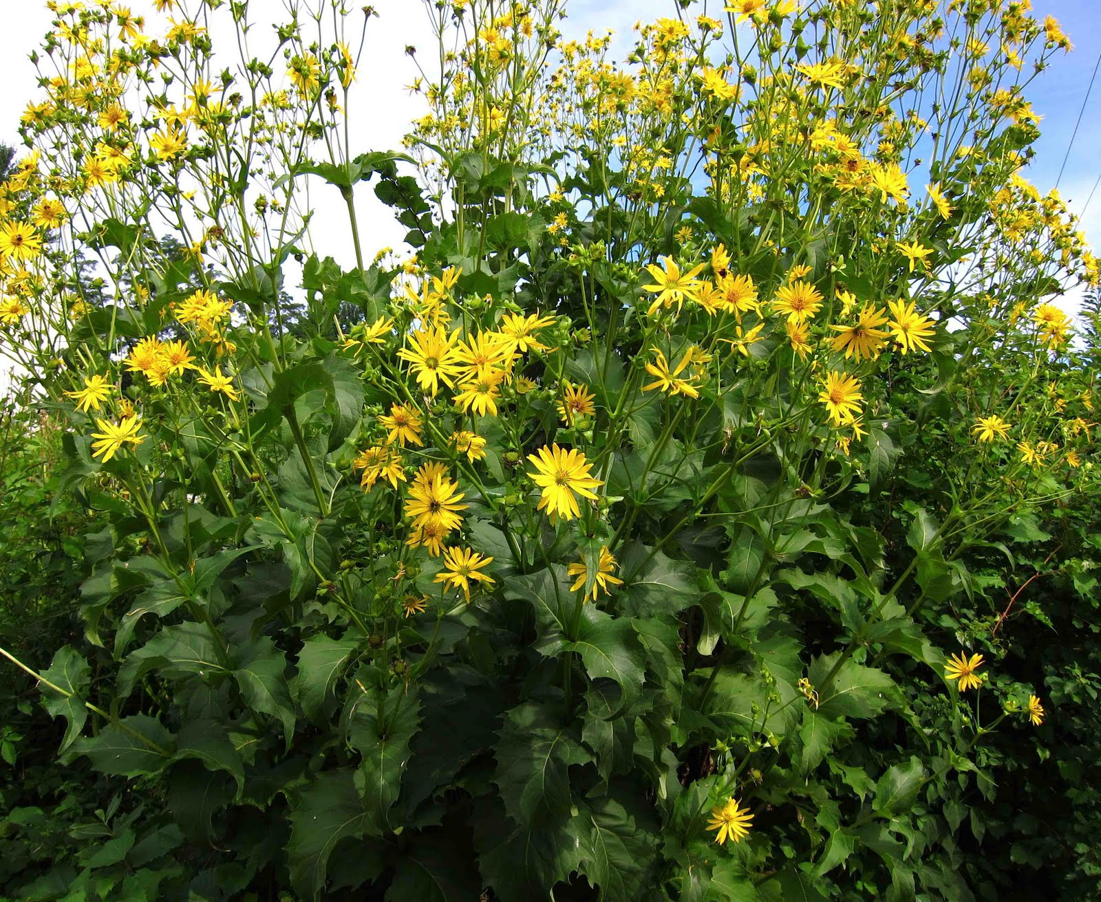
Experiment with two high biomass species of plants
Chinese silver grass
Miscanthus sinensis
Cup plant
Silphium perfoliatum

Slide 26
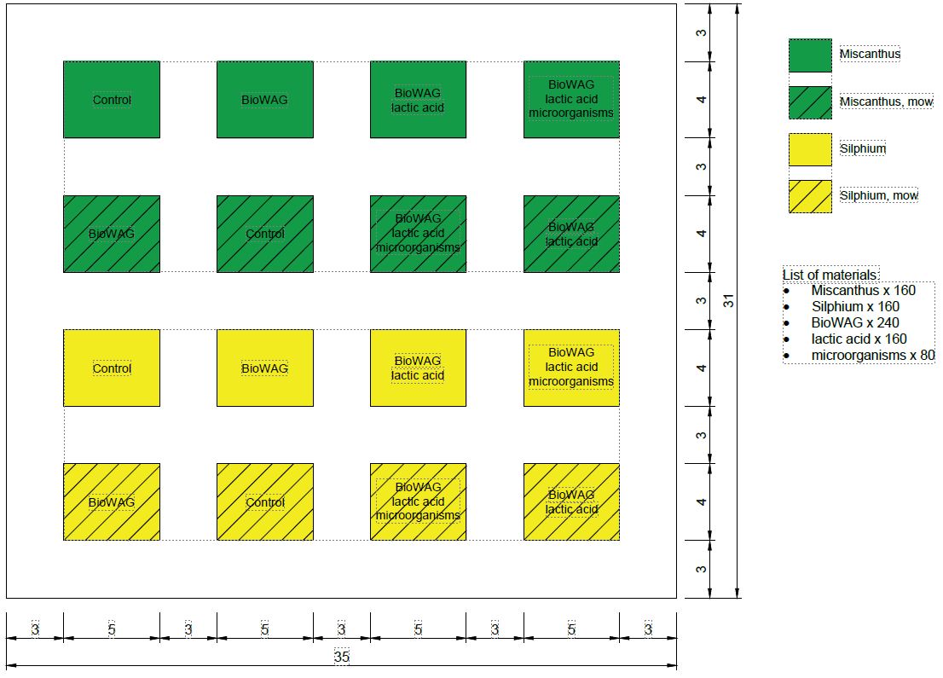
The experiment

Slide 27
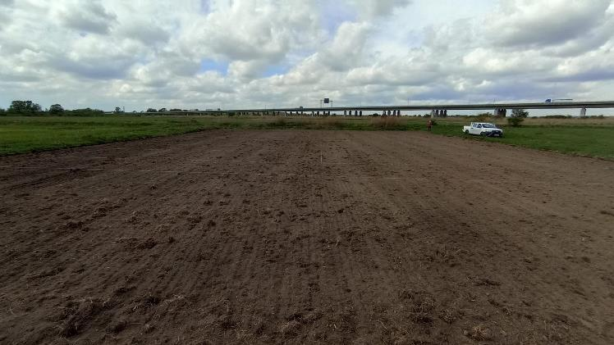
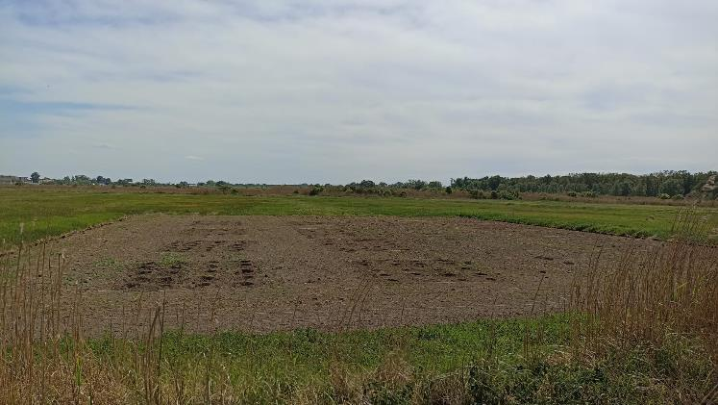
Field Experiment

Slide 28
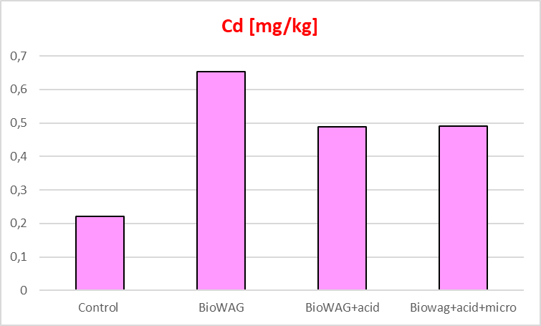
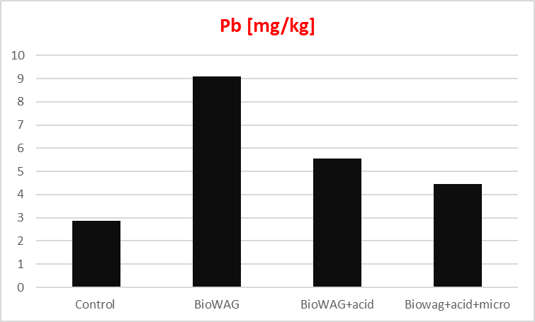
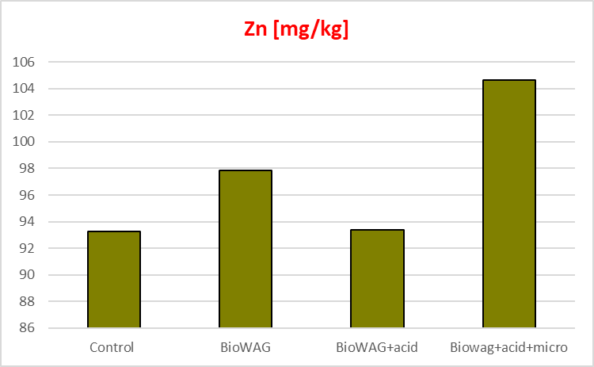
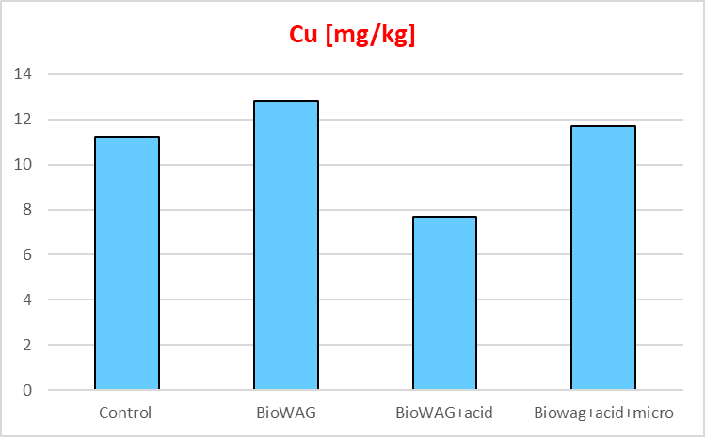
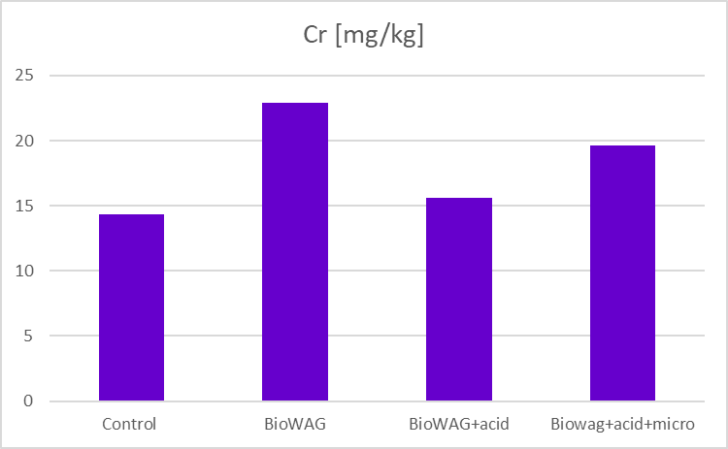
Results – metal concentration [mg/kg d.m]

Slide 29
Conclusions
The initial results are promising and show that BioWAG especially in combination with selected soil microorganism consortium can enhance heavy metals phytoremediation.
The results of our experiment demonstrated that treatments using BioWAG significantly enhanced the absorption of heavy metals from the soil compared to untreated controls.
This indicates that BioWAG, combined with specific soil microorganisms and organic acids, can effectively improve the efficiency of phytoextraction.

Slide 30
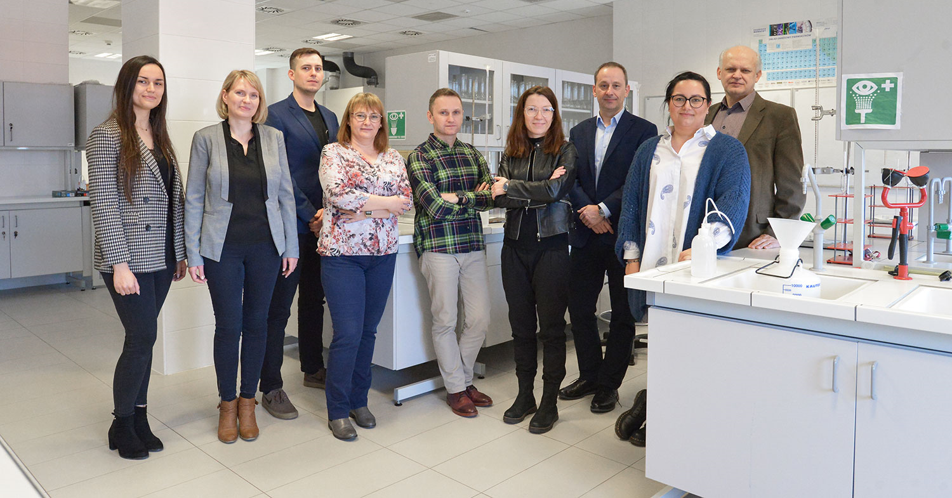
UPWr team

Slide 31

Symbiorem team

