Slide 1
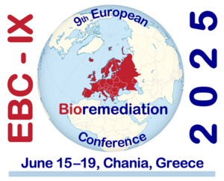


Symbiotic, circular bioremediation systems and biotechnology solutions for improved environmental, economic and social sustainability in pollution control
Leire Ruiz Rubio, University of The Basque Country
ALL4BIOREM cluster workshop, EBC-IX, Chania, Crete, 19th June 2025

Slide 2

















The SYMBIOREM Consortium
Coordinator: University of the Basque Country (EHU)
Consortium: 15 partners from 10 countries

Slide 3
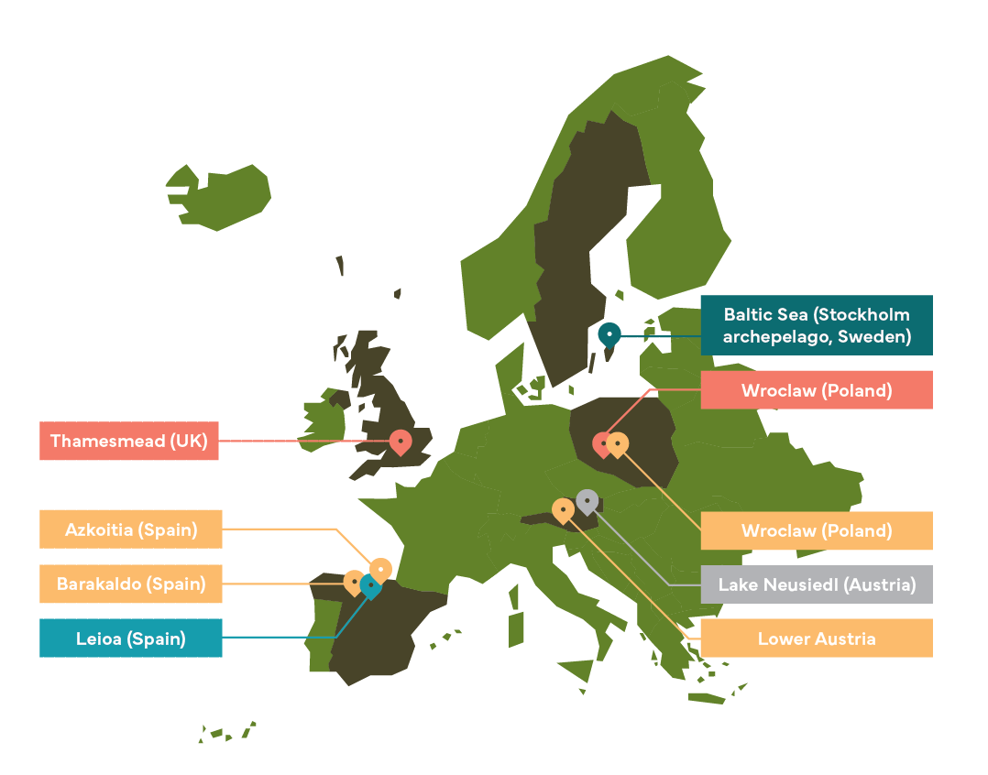

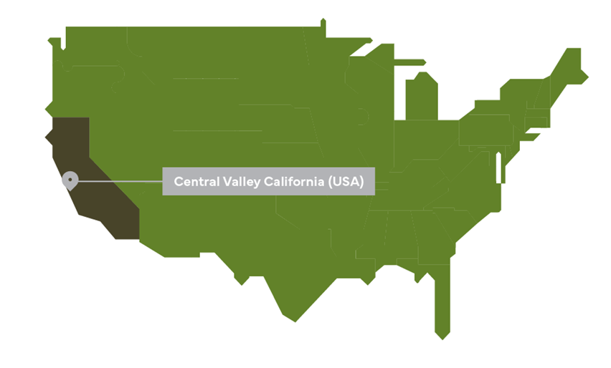


12 novel bio-based technologies and strategies
SYMBIOREM project aims to utilize symbiotic relationships between plants and microorganisms for pollution remediation and ecosystem restoration.
Soils
Surface water, groundwater, sediments
Sea water and marine sediments
Industrial brownfield
Mixed solid waste landfills
marine sediments
Urban diffuse pollution of surface water bodies
Agricultural drainage

Slide 4
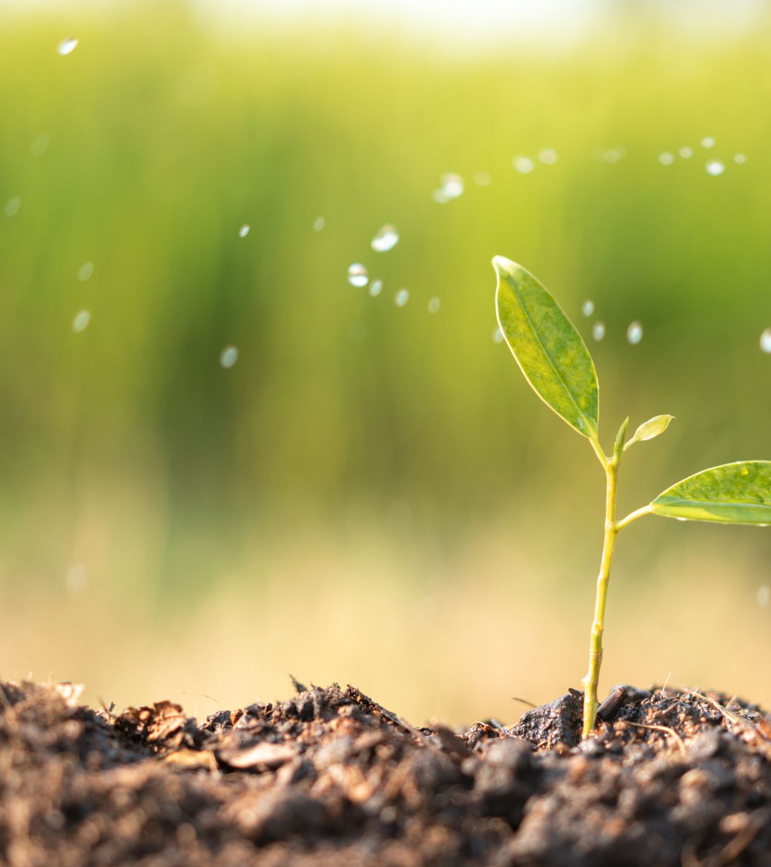
Strategies for contaminated soils

Slide 5
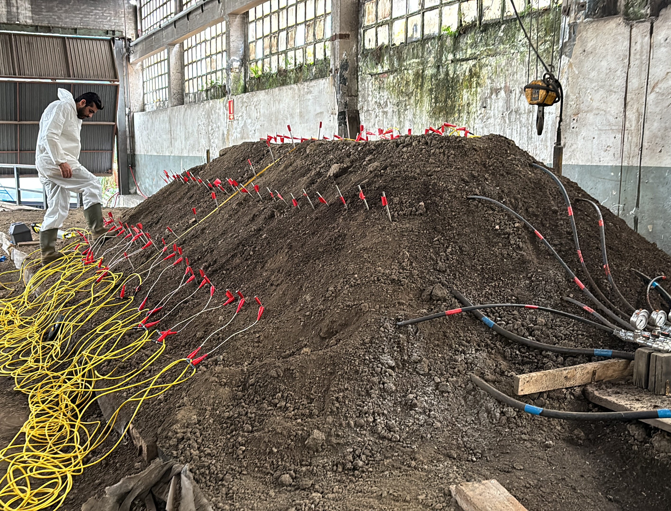
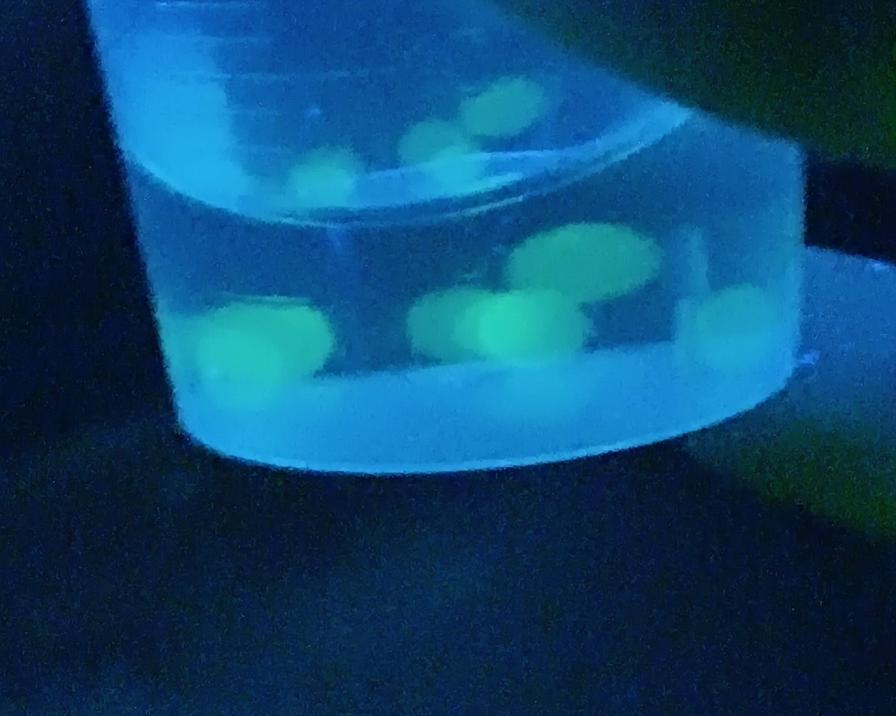
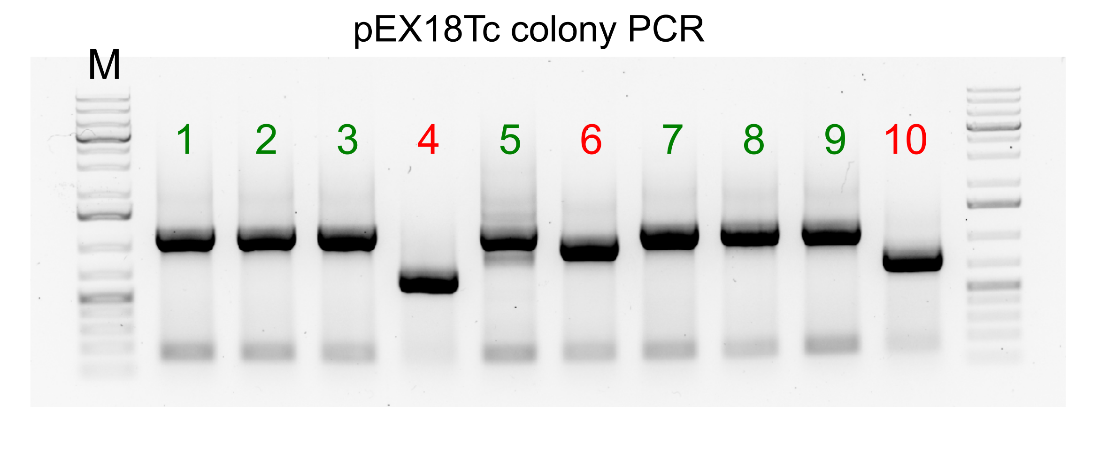
Development of bioremediation and recovery strategies for contaminated soils
Isolation, identification and assessment of the hydrocarbon-degrading capacity of autochthonous strains from contaminated soil
Biostimulation strategy with (micro)encapsulated nutrients at microcosmos and semi-pilot scale
Bioaugmentation strategy with microbial consortium and polysaccharide carriers
Safety gene Bioaugmentation: Construct Pseudomonas aeruginosa auxotrophic for methionine and able to degrade Toluene using genetic engineering.

Slide 6
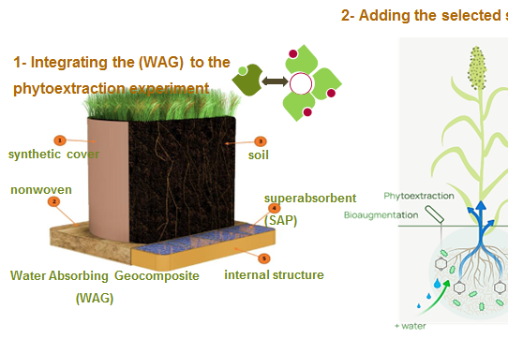
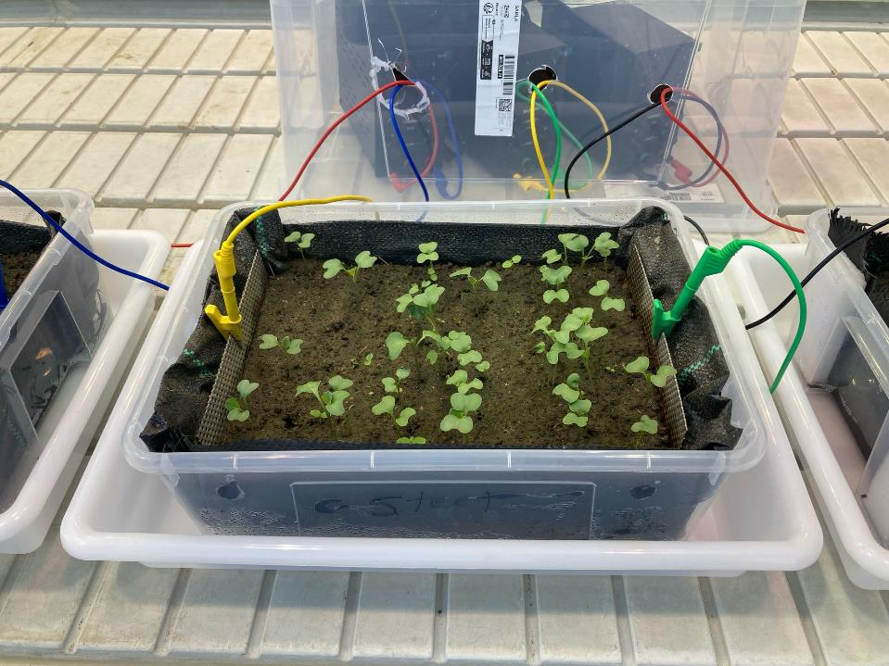
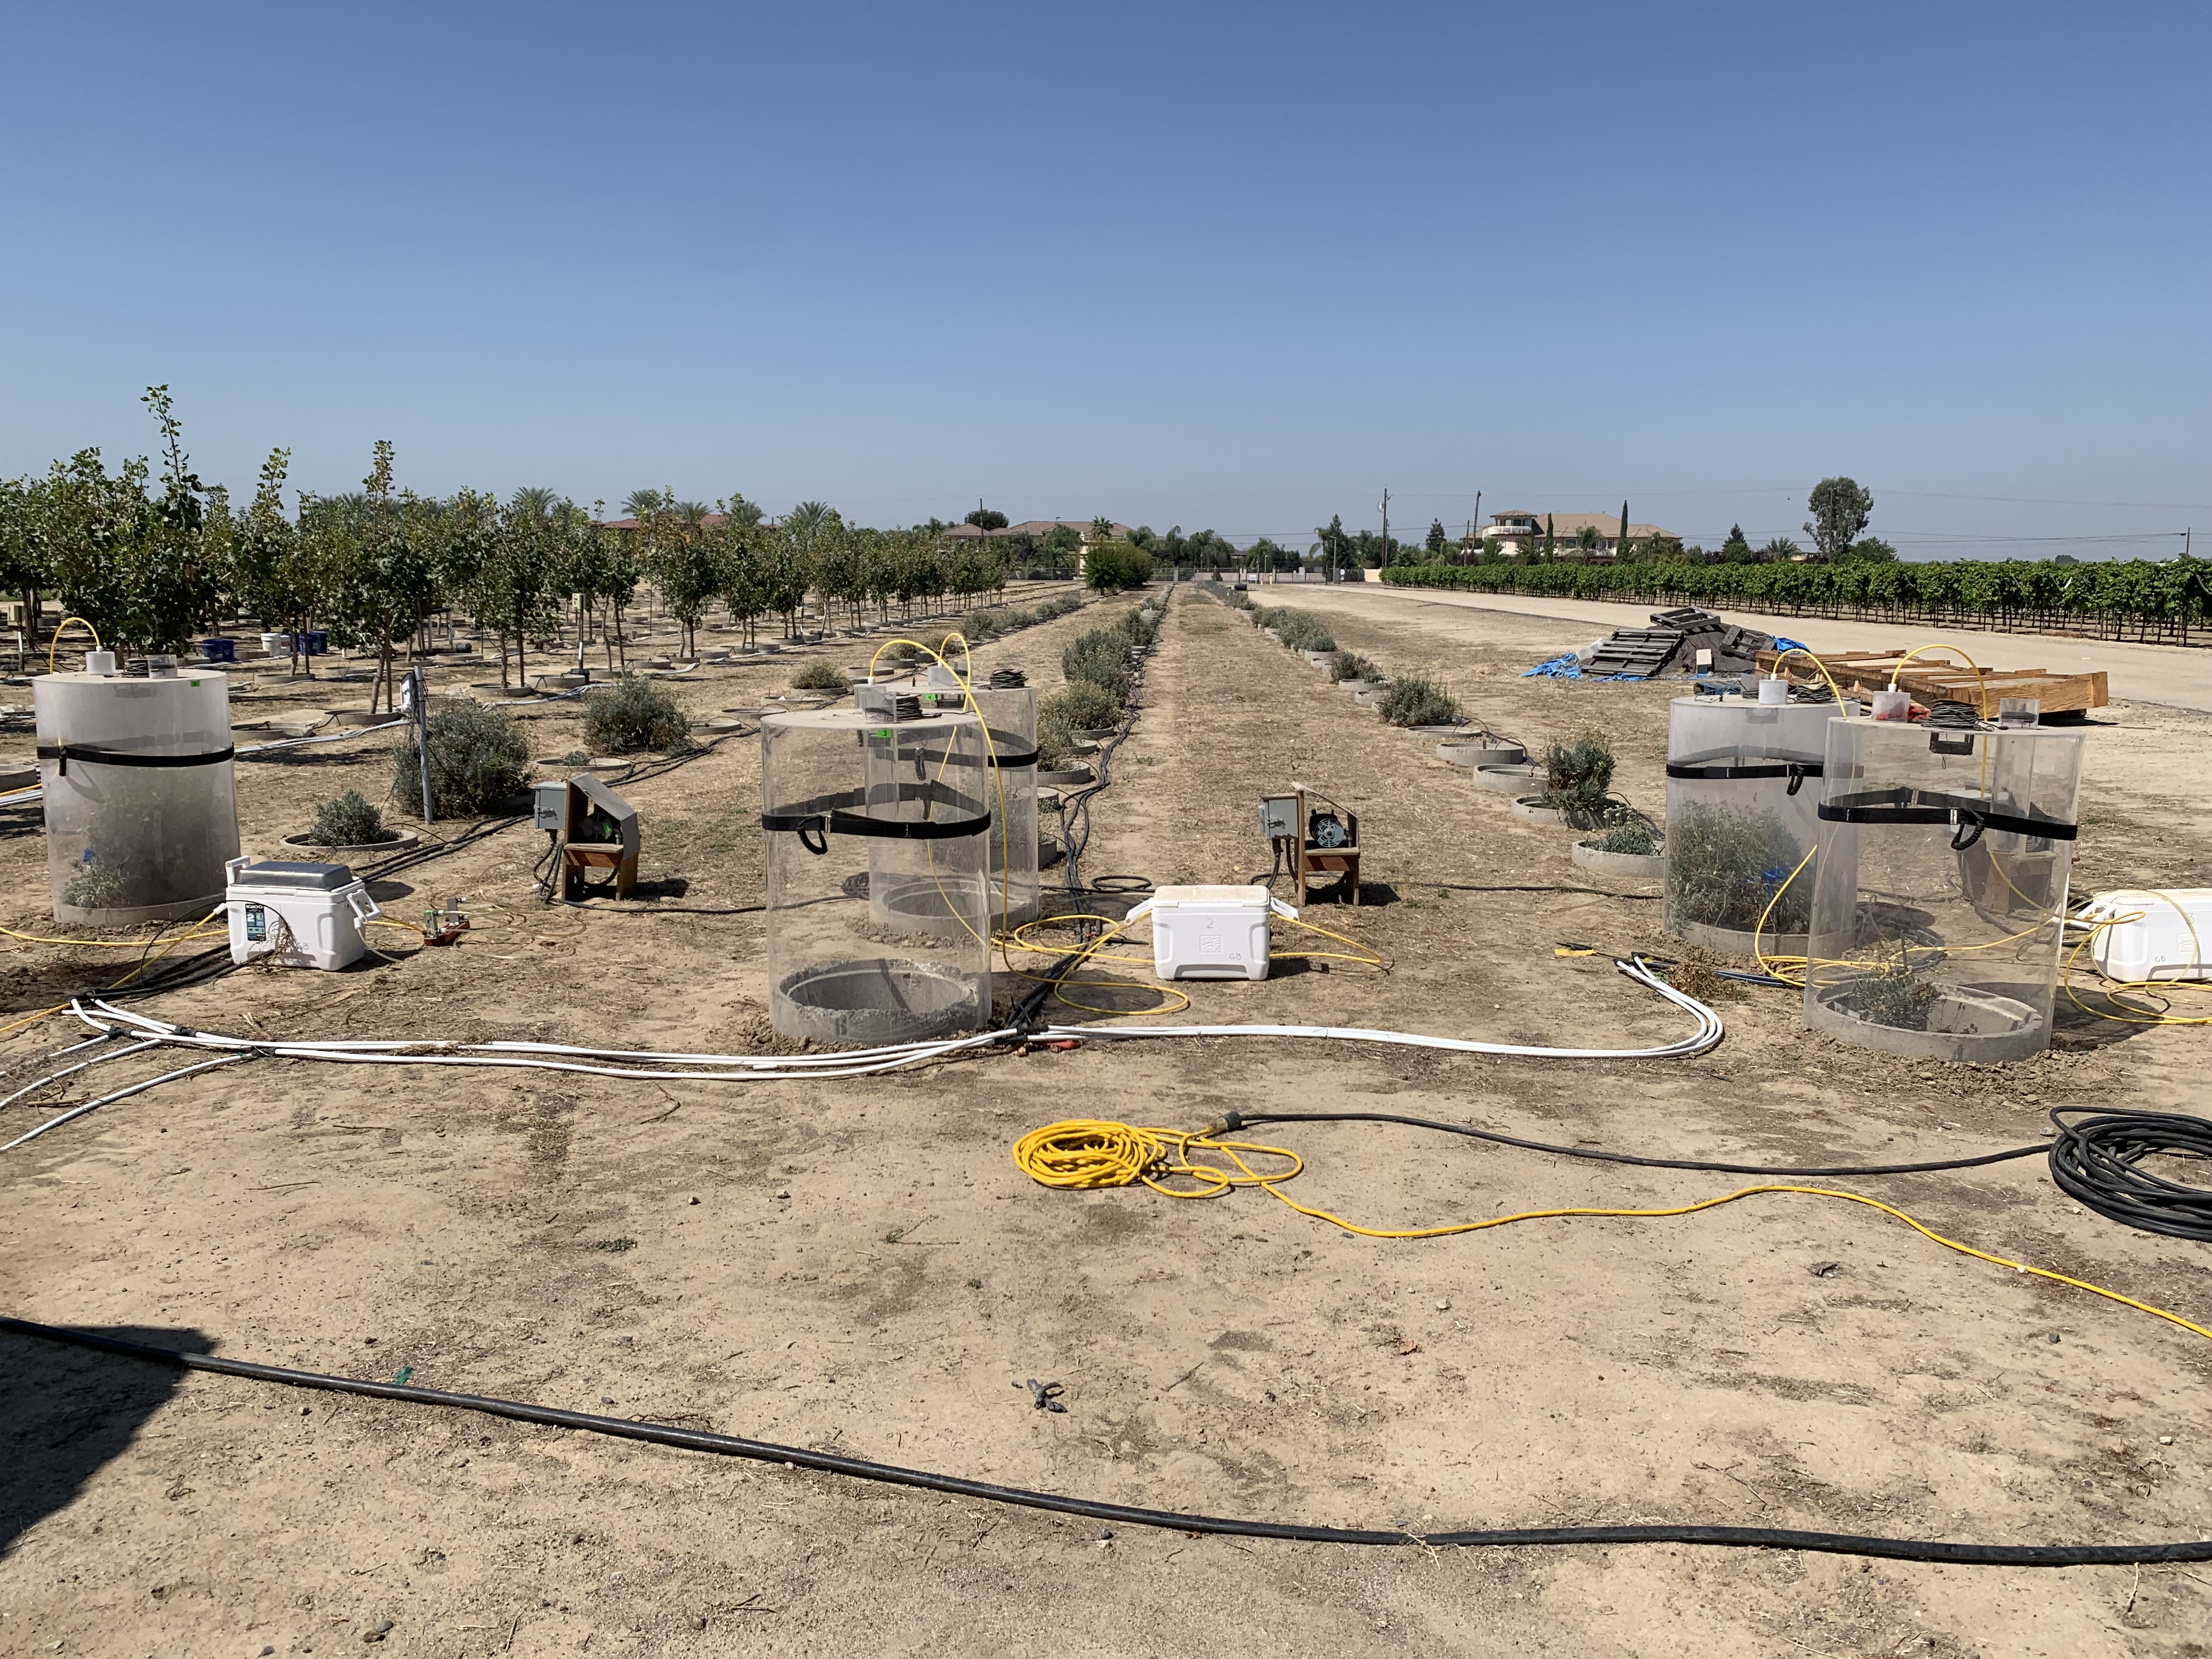
Development of bioremediation and recovery strategies for contaminated soils
Phytoextration: develop a new technology for phytoextraction of metals from soil with the use of water-absorbing geocomposites (WAG) based on sustainable methods, materials, and amendments.
Electrophytoremediation: Bioelectrification enhanced phytoremediation of PAH or hydrocarbon contaminated soil.
Phytomanagement: Using saline drainage water to grow guayule (a salt and boron tolerant crop) that produces natural latex and resin.

Slide 7
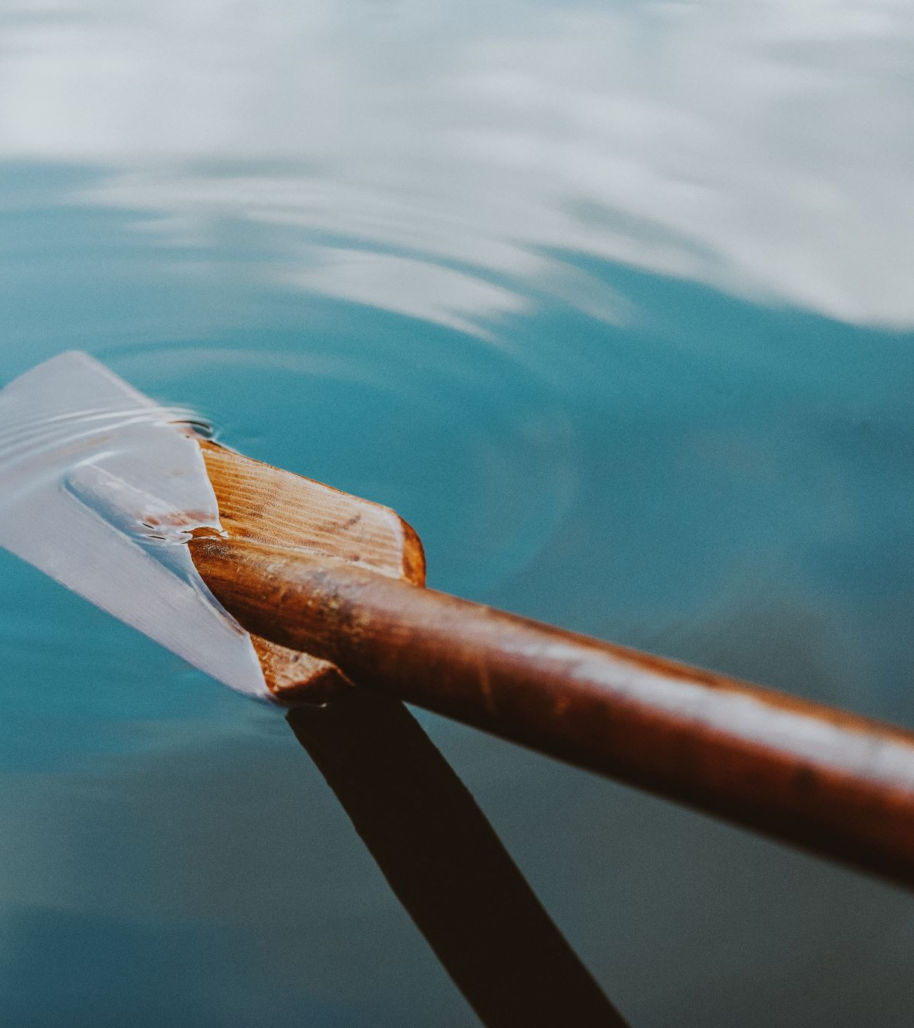
Strategies for contaminated water and sediments

Slide 8
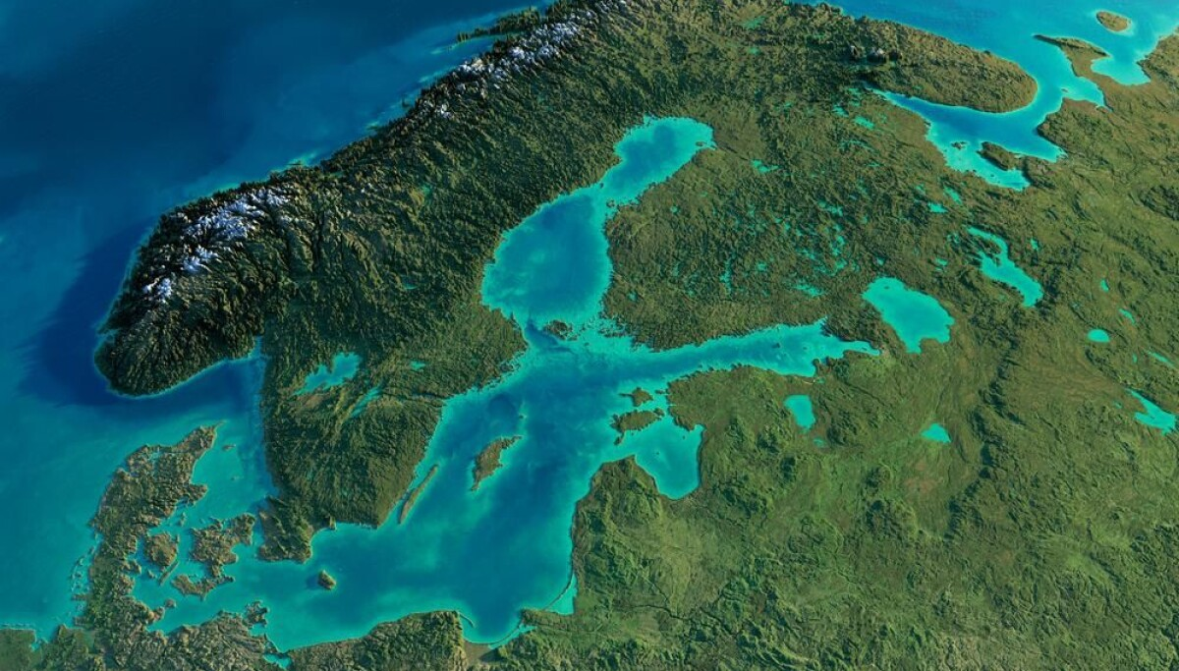
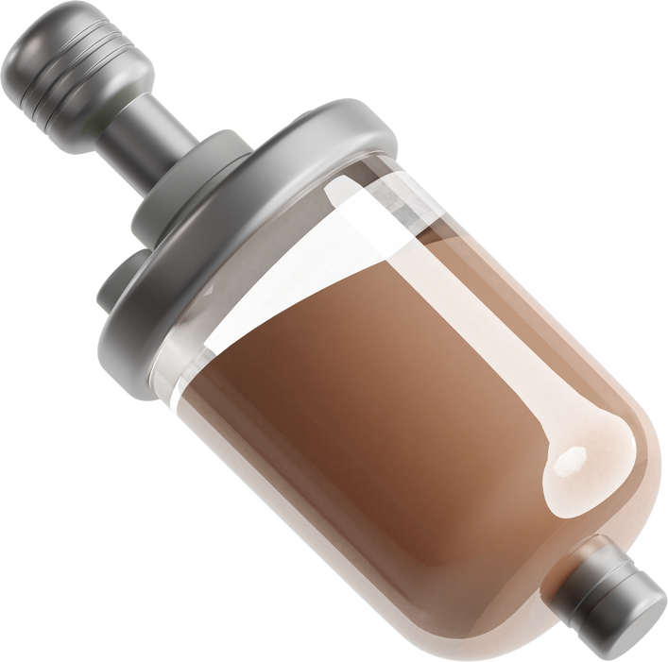
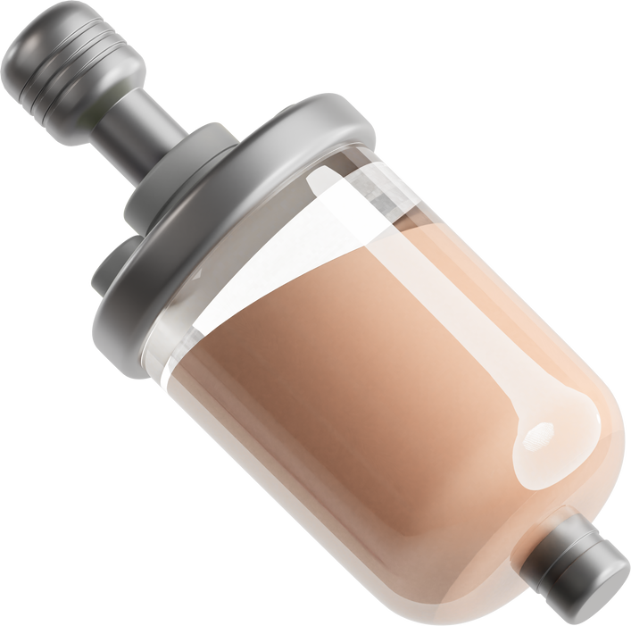

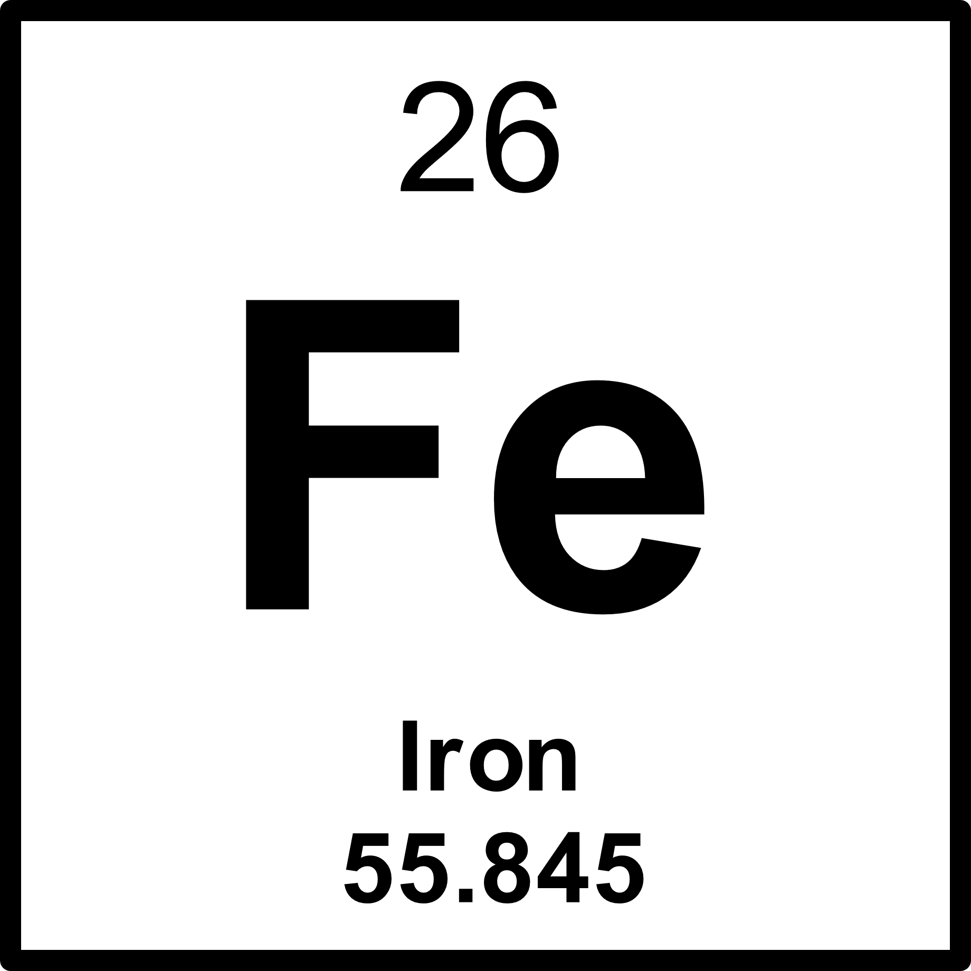

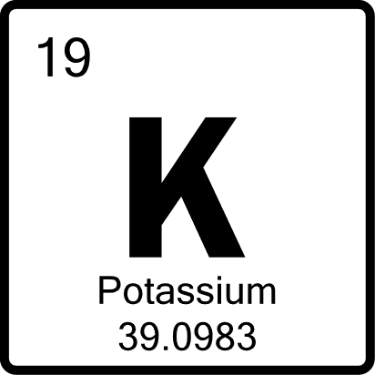
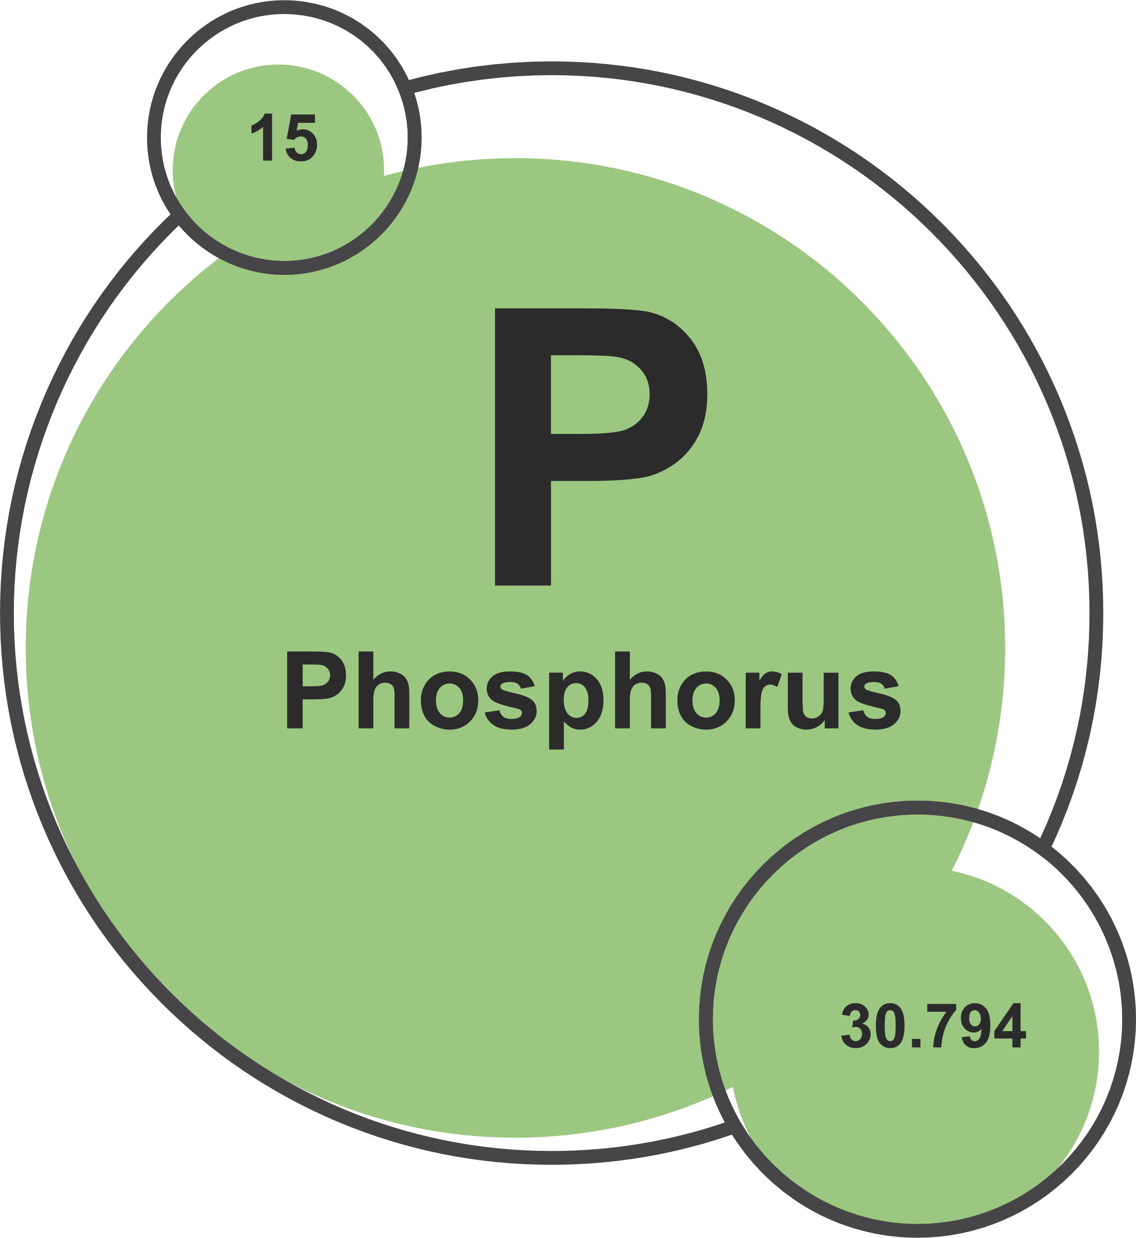
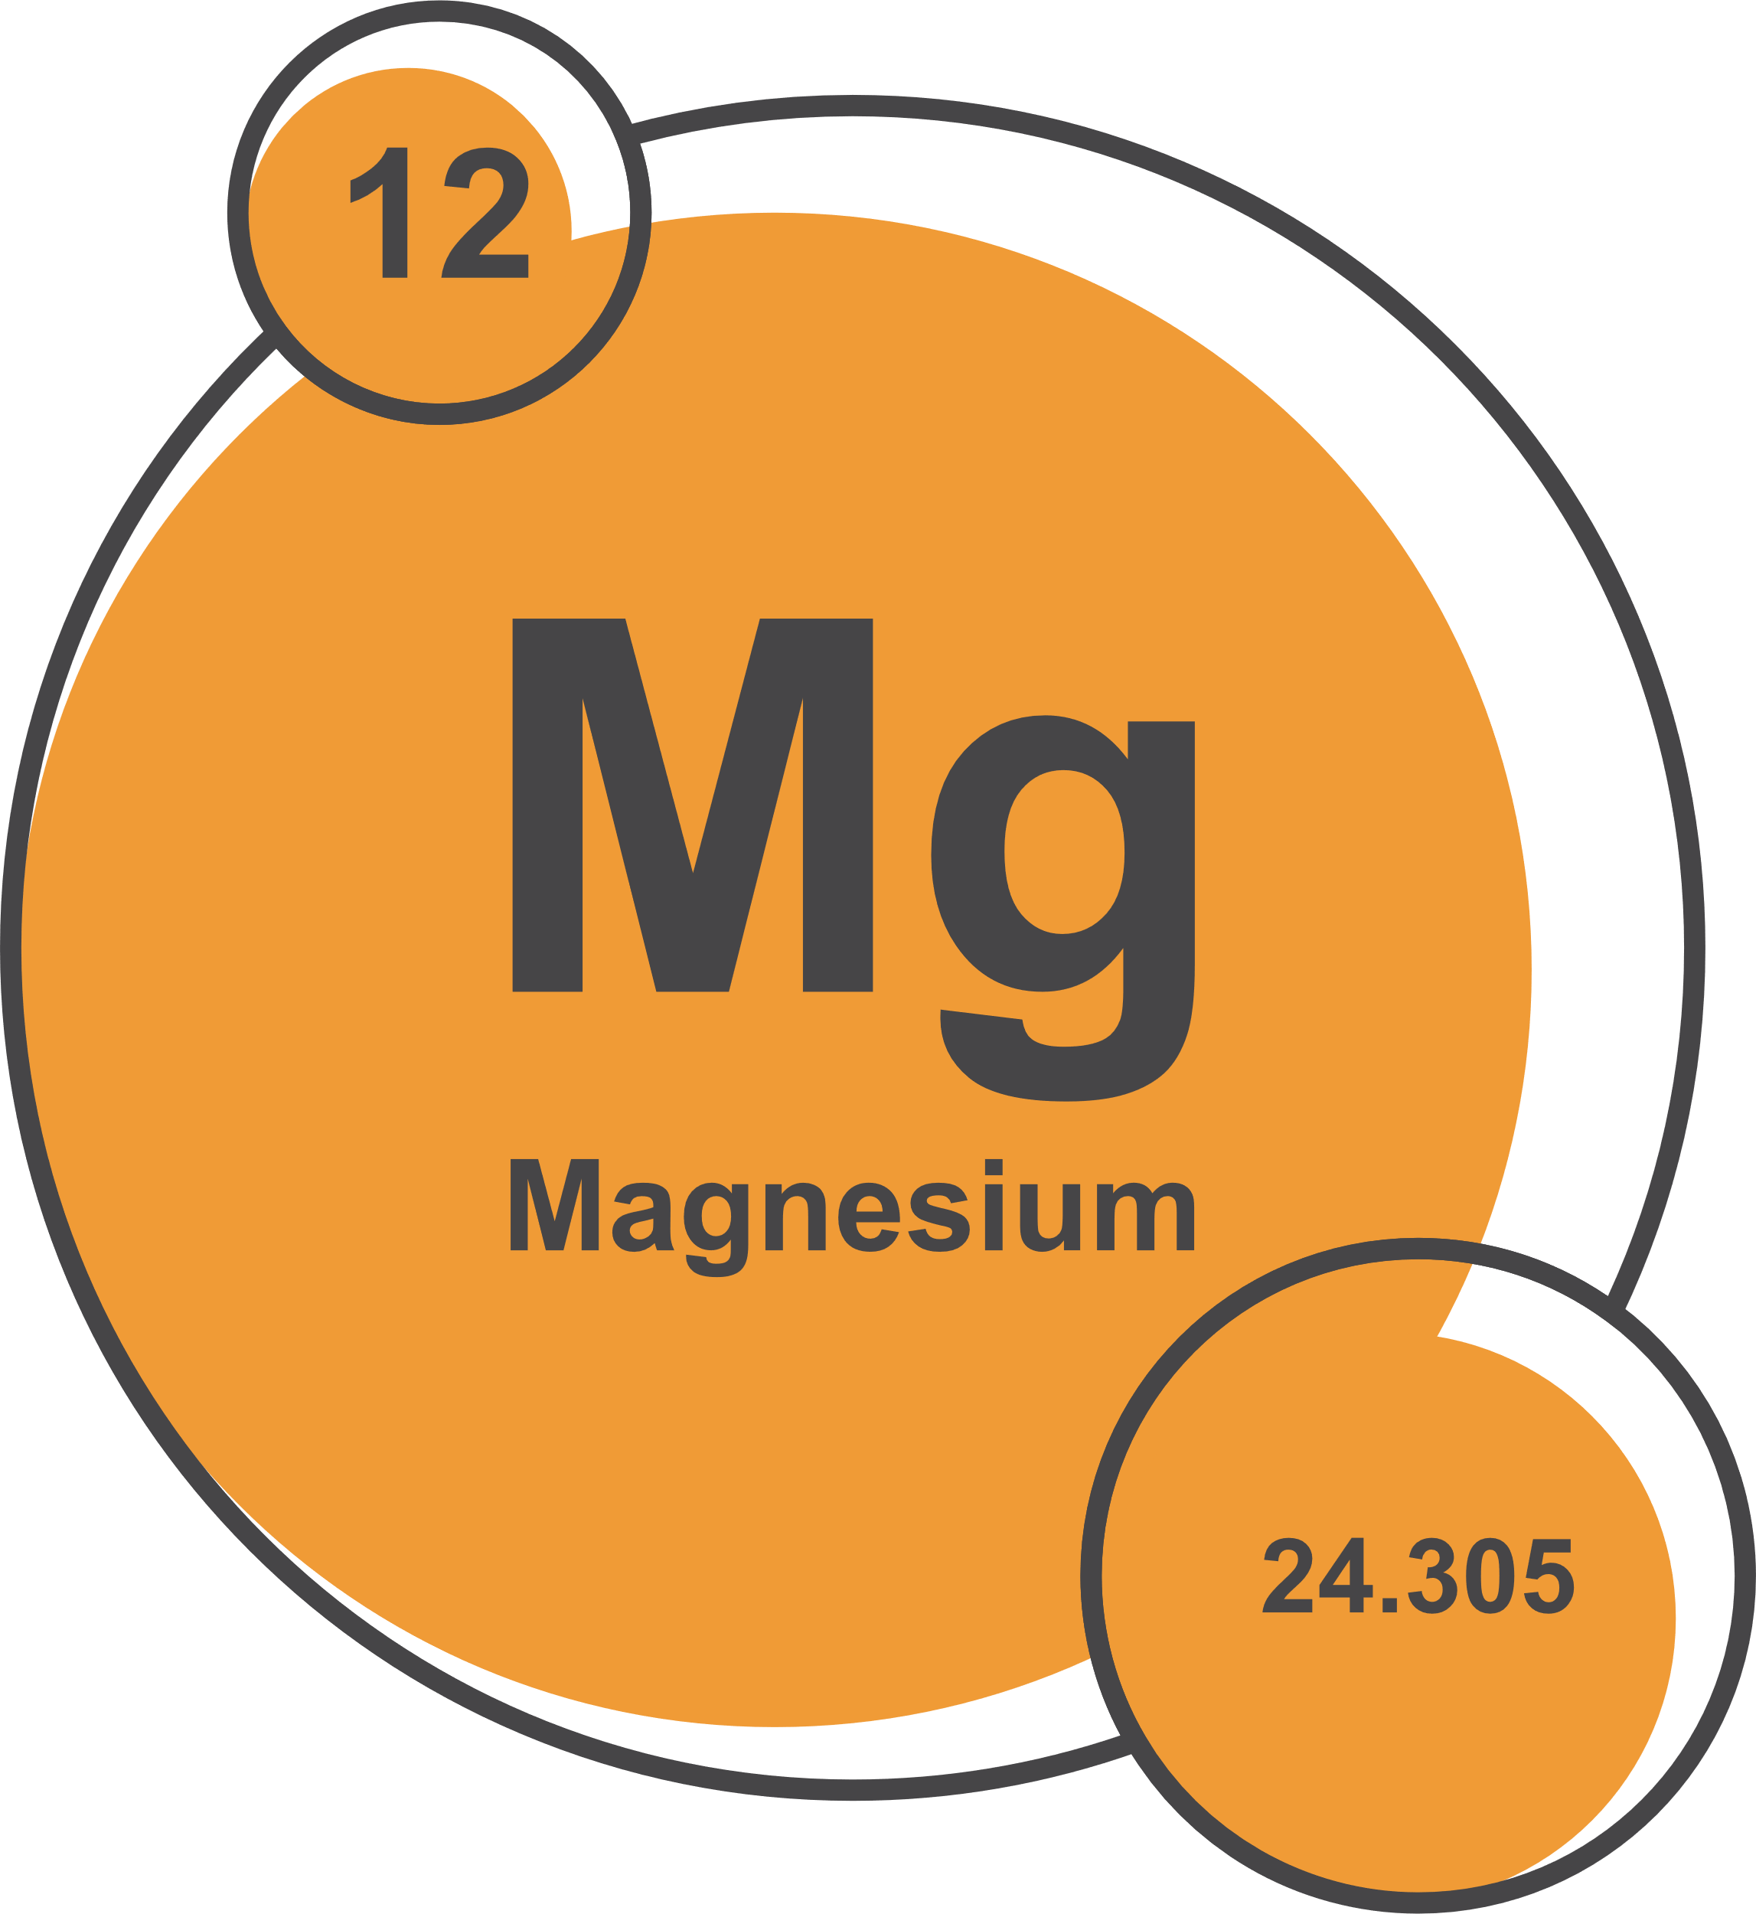
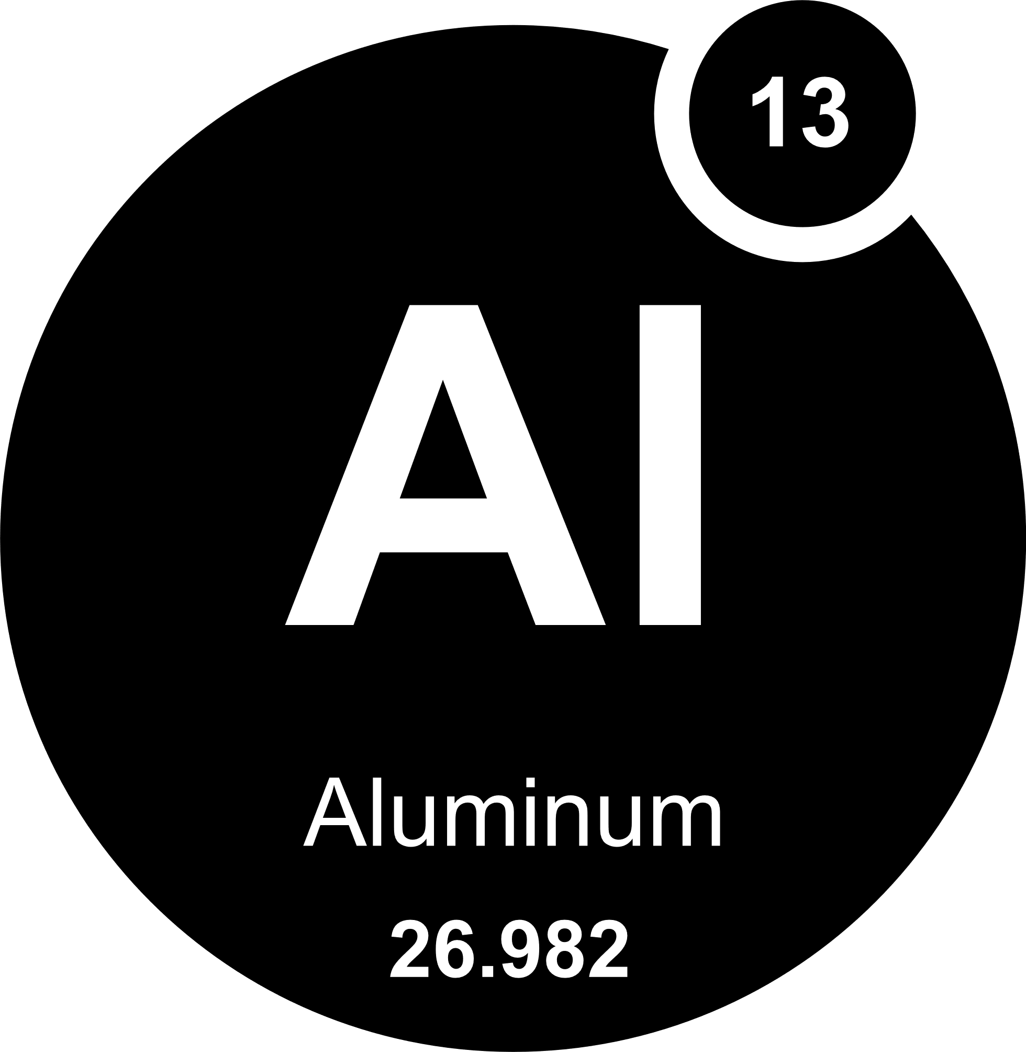
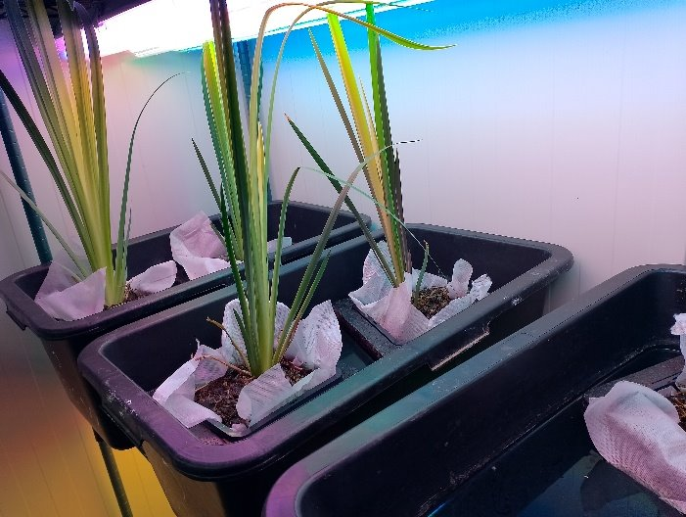
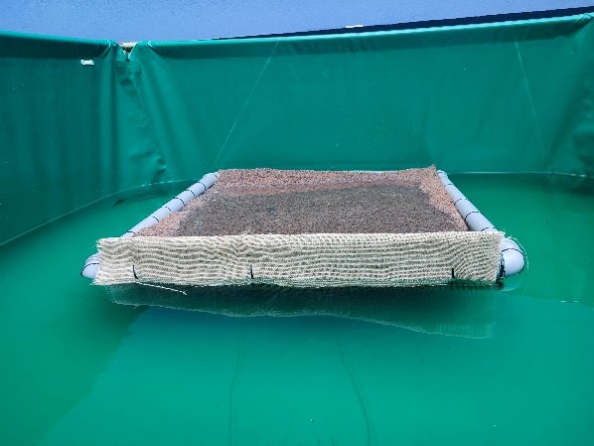

Development of bioremediation and recovery strategies for water and sediments
Design cascade bioreactor system combining bioremediation and recovery strategies for the contaminated marine environments
BIOLEACHING REACTOR
REACTOR 1
REACTOR 2
Baltic Sea Sediment
REMEDIATION
RECOVERY
s://www.sciencenordic.com/denmark-farming-the-oceans/the-baltic-sea-needs-an-intervention/1455257
Immersed active surface using bacteria, yeast and fungi combined with floating wetlands ​

Slide 9
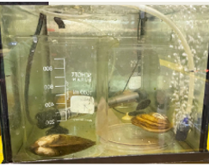
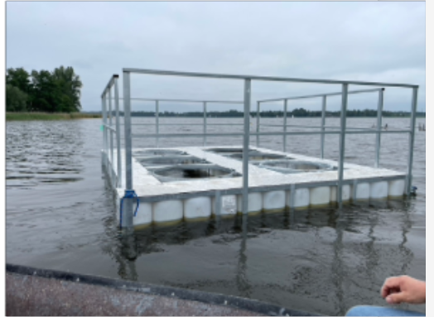
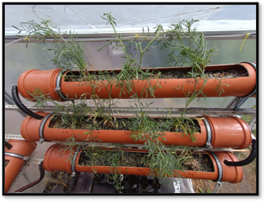
Development of bioremediation and recovery strategies for water and sediments
Nature-based bioremediation solutions enhanced with microorganisms and freshwater mussels for surface waters with mixed contamination ​
Nature-based bioremediation for landfill leachate ​

Slide 10
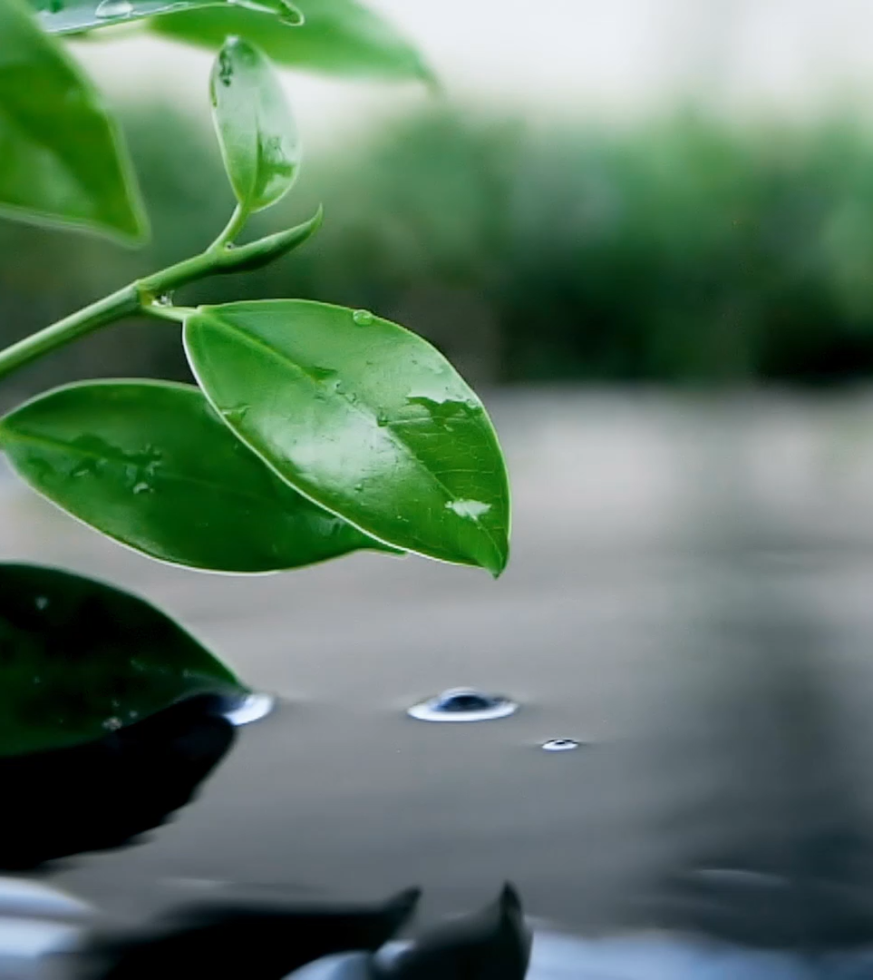
Scaling up and combination of developed biotechnologies

Slide 11
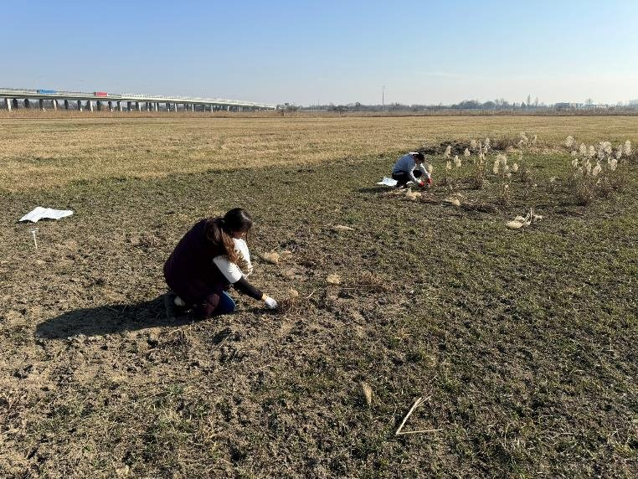
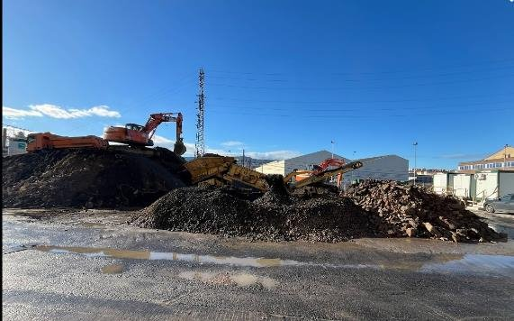
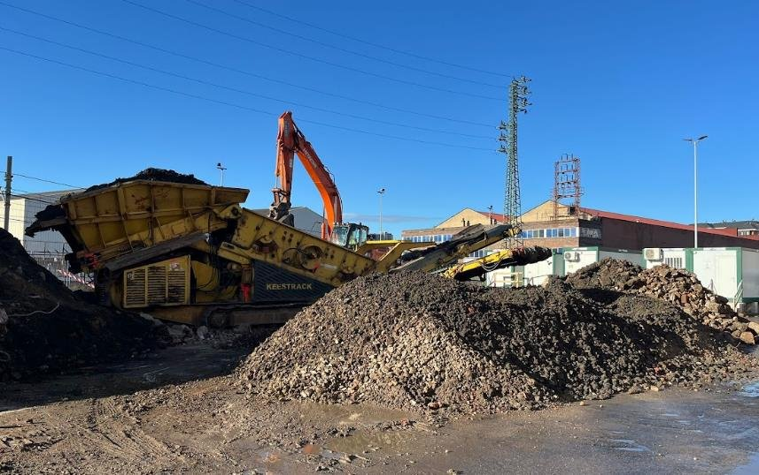
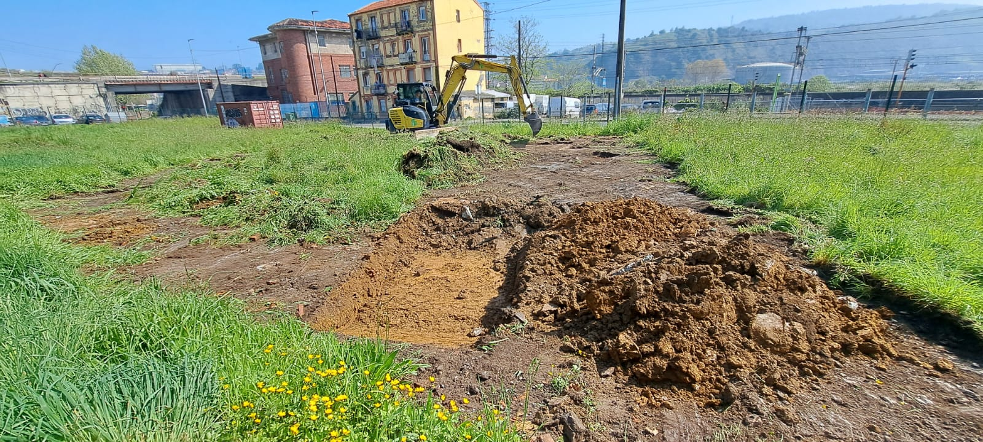
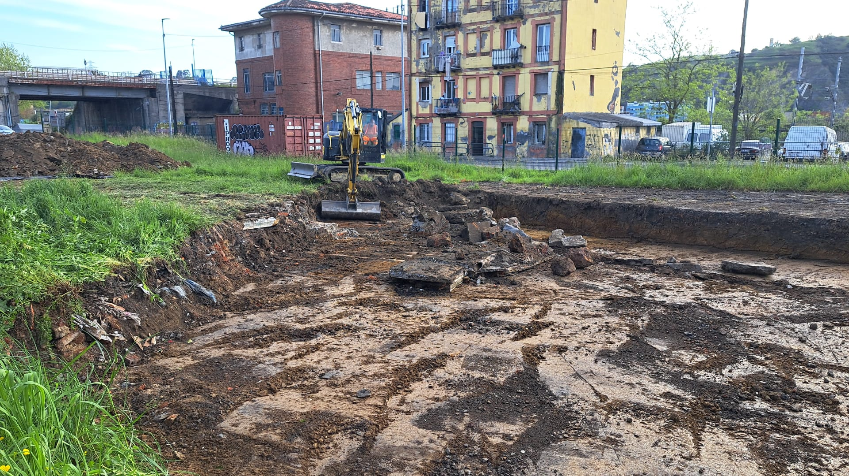
Scaling up of remediation strategies for soil
Osobowice, Poland
Lamiako-Leioa, Spain
Lutxana-Barakaldo, Spain

Slide 12
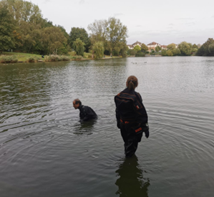
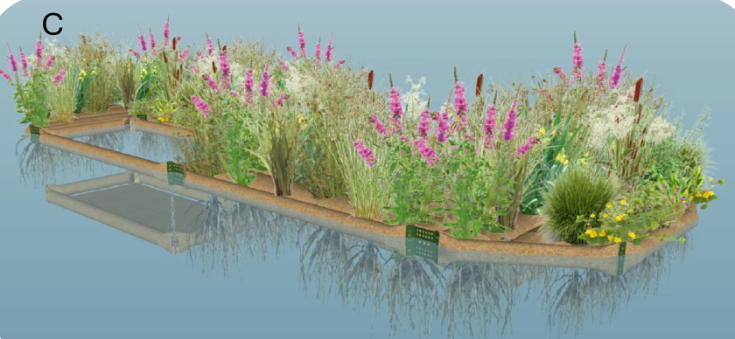
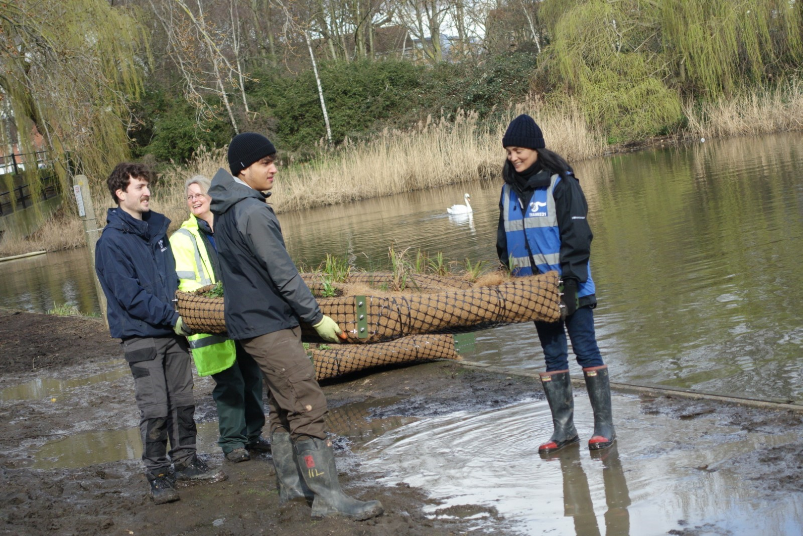
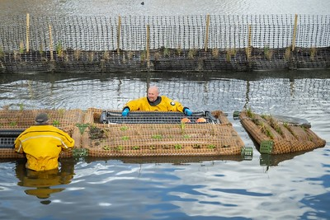
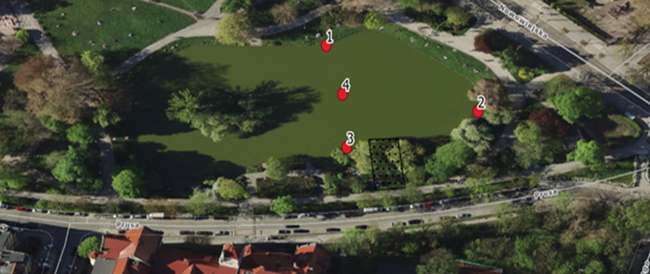
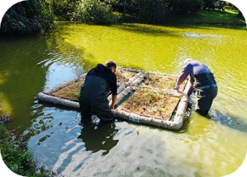
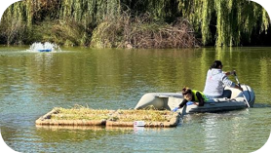
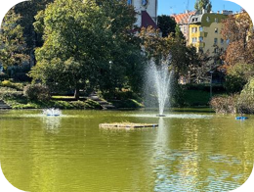
Scaling up of remediation strategies for water
Floating wetland based bioremediation in UK and Poland
Gallions Lake, Thamesmead, UK
Tołpa Park pond, WROCŁAW, Poland

Slide 13

Trust-building and citizen engagement activities

Slide 14
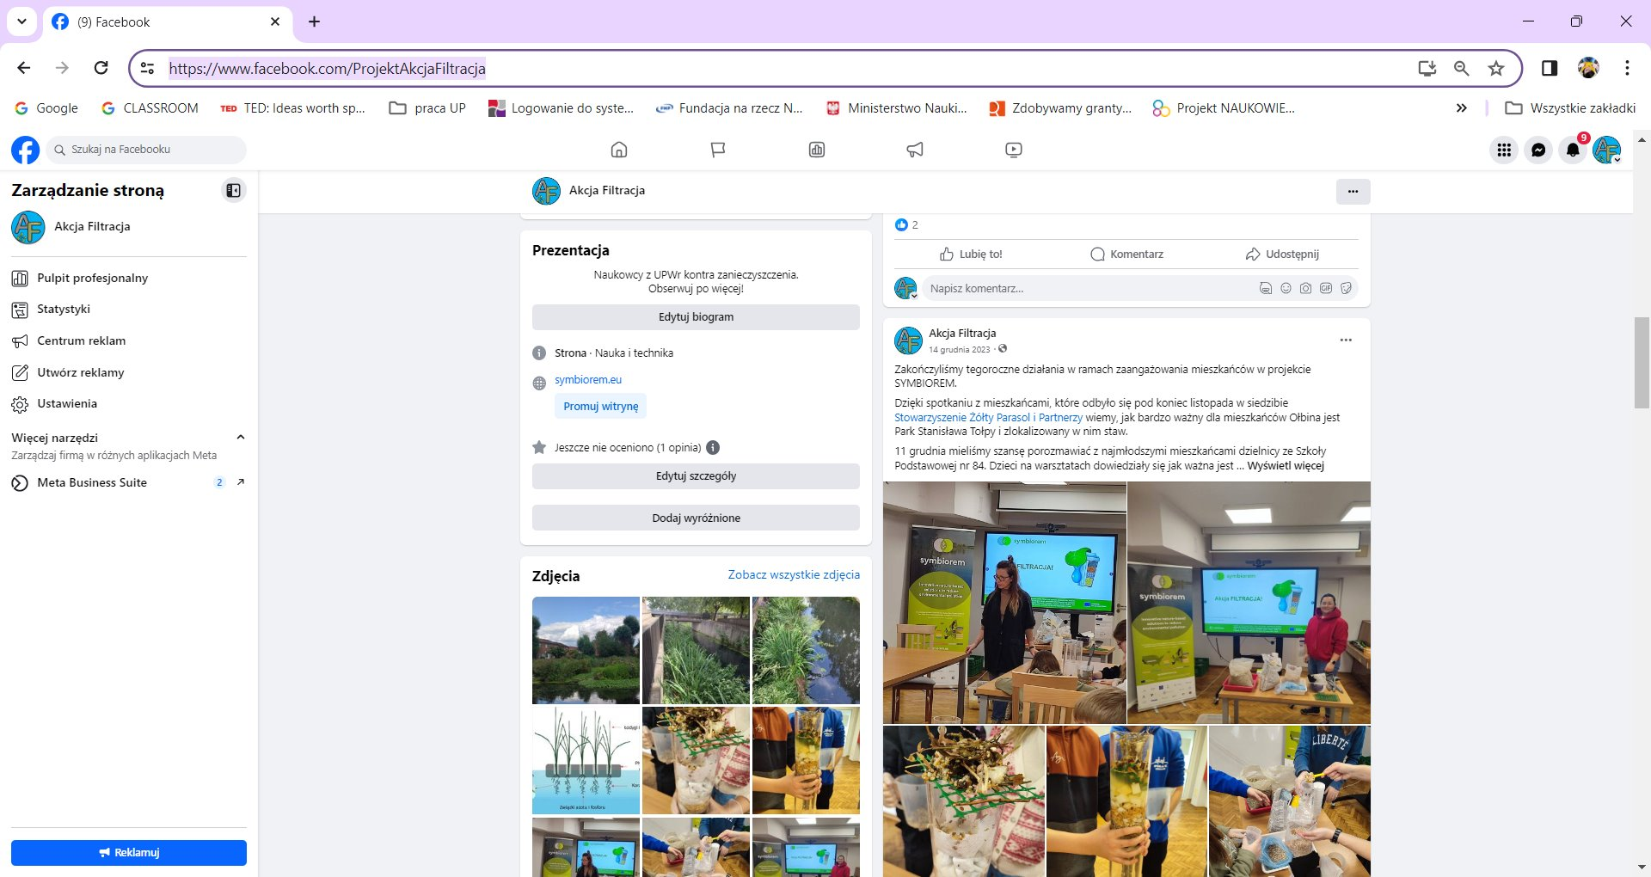
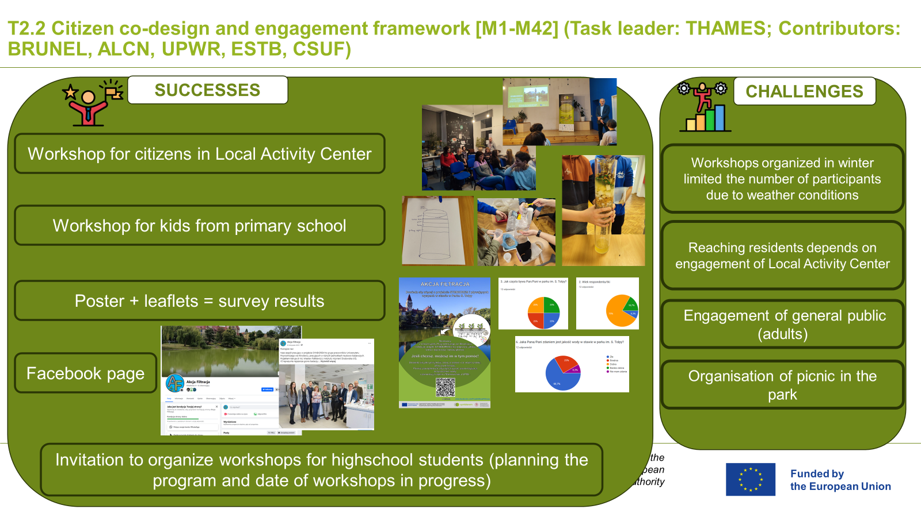
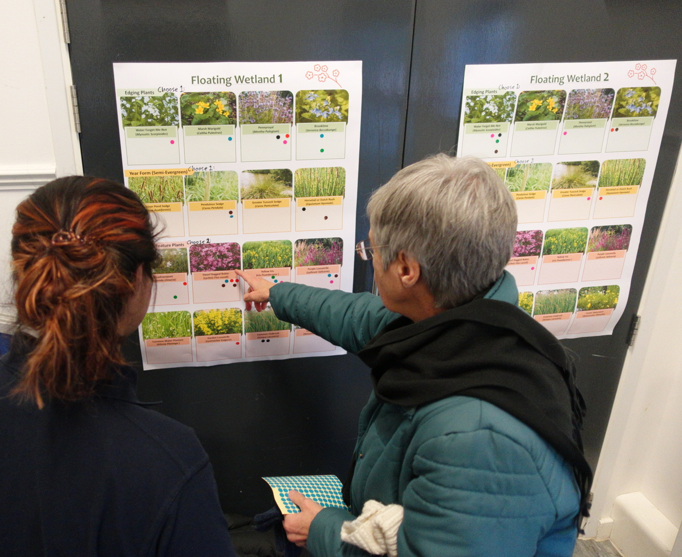
Citizen co-design and engagement framework
London (UK)
Poland
Austria
Spain
Events
Workshops for kids
Walks
Co-design
Workshops for local community

Slide 15

Some achievements
Isolation of microorganisms capable of degrading contaminants
Testing different conditions for stimulating degradation, with organic amendments yielding best results
Designing DNA construct for specific metabolic pathways
Installation of floating treatment wetland in Gallions Lake, UK and Wroklaw, Poland
Experiments on adding substances like glucose to remove PAHs in the Baltic Sea
Lab tests on mussels' ability to reduce nutrients and algae, including toxic cyanobacteria
Assessing impact of nanoplastics on mussels
Engaging citizens through toolkits, questionnaires, discussions, and local events
Community involvement in various stages of the project in the UK, Poland, Spain and Austria

Slide 16



https://symbiorem.eu
@symbiorem
@symbiorem_eu

